Slide 1
Birth of modern agricultural extension services
Outbreak of potato blight in Europe in 1845 (Potato Famine in Ireland in 1851)
Royal Agricultural Improvement Society of Ireland (founded in 1841) appointed itinerant lecturers
Four years of its existence the scheme was funded to about half its total cost by landowners and charitable donations with the remainder coming from government-controlled funds
Mid-1850s, first in Württemberg, Hesse, and western Prussia, itinerant agricultural teachers (Wanderlehrer) began to be appointed under the auspices of central agricultural societies
System grew rapidly, influenced in part by the crisis among vine growers resulting from the devastation caused by phylloxera aphid infestations

Slide 2
System was adopted in the kingdom of Bavaria in 1896, it was as an integral part of the state civil service; the extension workers were grandly titled Royal Agricultural Teachers (Königliche Landwirtschafts-lehrer)
In France the first national, wholly state-funded agricultural extension service was established in 1879

Slide 3
Extension in USA
Morrill Act of 1862, was seminal in the creation of state colleges "of agriculture and the mechanic arts" in the northern United States;
Its land-grant provisions enabled the states to establish and fund their colleges.
Beginning at about the same time of the farmers' institute movement.
By 1890, second Morrill Act granted federal funds for the establishment of agricultural colleges in the remainder of the United States,

Slide 4
The farmers' institutes had spread throughout and become a national institution with federal support and supervision, further stimulated by the formal establishment of experimental work at the state colleges of agriculture under the 1887 Hatch Act.
1914 with the passage of the Smith-Lever Act, established the Cooperative Extension Service - a tripartite cooperation of federal, state, and local county governments, with the state college as the extension agency

Slide 5
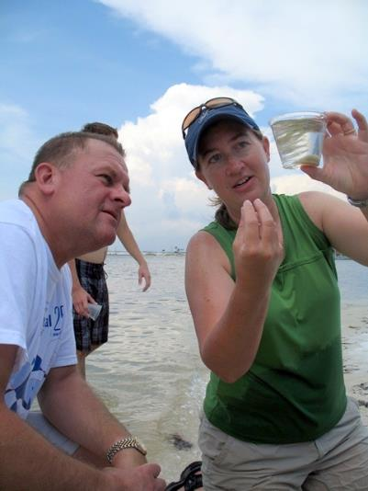
Why was the National Cooperative Extension System Created?
– Building a rich, vital, democratic culture through pooling scientific knowledge with local knowledge and experience in cooperative educational work that develops the full-range of people’s individual and community capacities and well-being.
Notes:
For what is the object of Extension work? More bushels of corn? More bales of cotton? More pounds of butter-fat in the dairy cow’s annual record? More quarts of fruit and vegetables canned for winter use?
No, these are but means to an end. The end, the object of Extension work, is to aid the farmer and his family to improve living conditions on the farm, to provide a more satisfying rural life.
Better crops, better livestock, better food, better clothes, these are among the objects of Extension work.
But back of it all, the ultimate purpose is to create better homes, better citizens, better communities, better rural living.

Slide 6
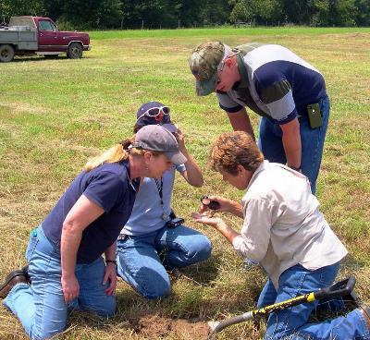
Guiding Principles for Extension
Reach people where they are:
- Education, interest, understanding, and ability
- Teach people to determine their own needs
- Teach people to “help themselves”
Notes:
Guiding Principles for Extension
Reach people where they are:
- Education, interest, understanding, and ability
- Teach people to determine their own needs
- Teach people to “help themselves”

Slide 7
Cooperative Extension is....
A Partnership of funding and operations
Federal (USDA)
State
Local (County)
Notes:
Extension is a Partnership of Funding and operations , Federal (USDA), State (Florida), Local (67 Counties)

Slide 8
India
A central department of agriculture was established in India after the famine in eastern India (Bengal, Odisha) and the government of India soon after resolved to establish departments in each province.
Central government directive ordered every province to appoint a full time director of agriculture (1905)

