Slide 1
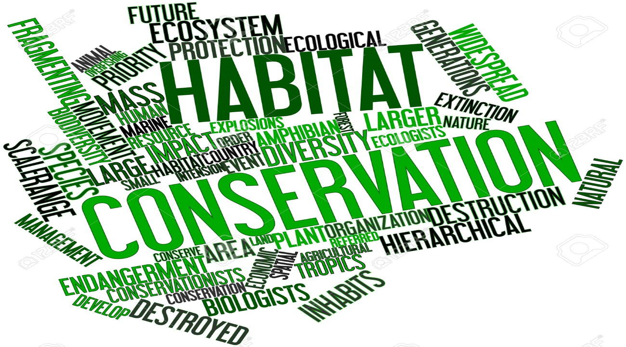
HABITAT CONSERVATION

Slide 2
Habitat
“A habitat is an ecological or environmental area that is inhabited by a particular species of animal, plant, or other type of organism. The term typically refers to the zone in which the organism lives and where it can find food, shelter, protection and mates for reproduction. It is the natural environment in which an organism lives, or the physical environment that surrounds a species population.”

Slide 3
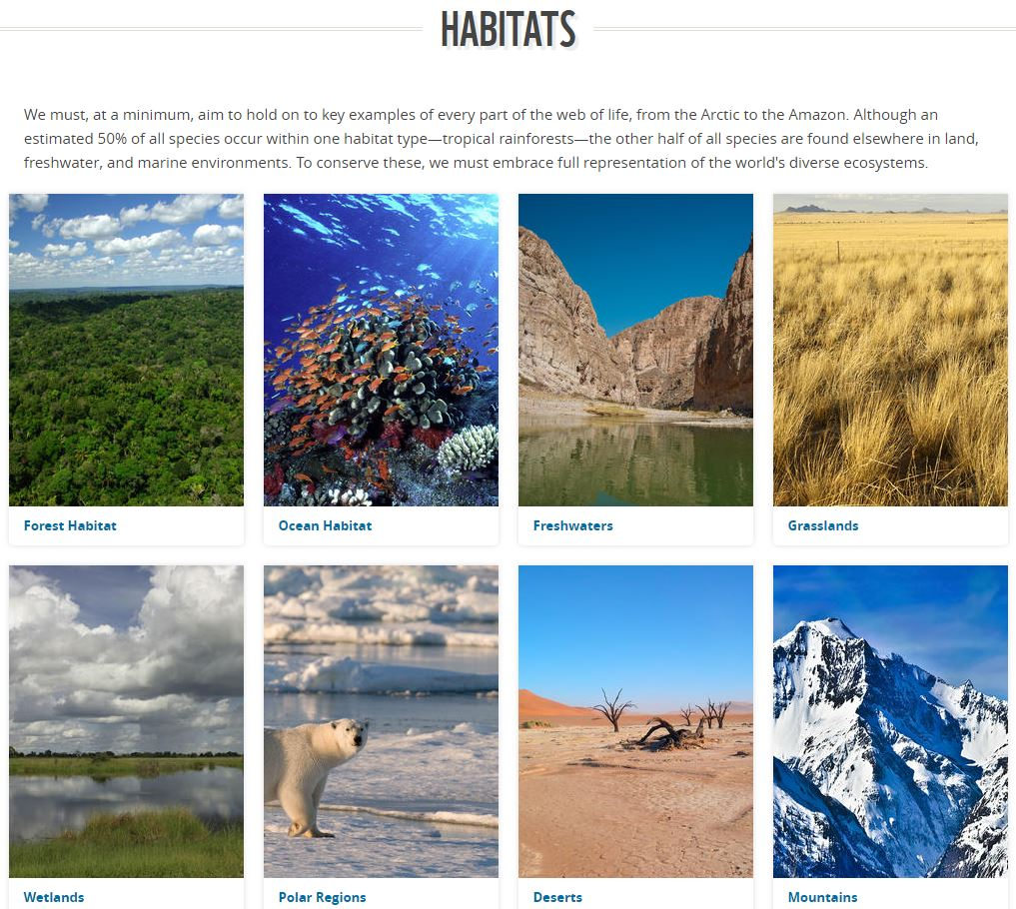

Slide 4
Kinds of Habitat Loss Habitat destruction:
A bulldozer pushing down trees is the iconic image of habitat destruction. Other ways people directly destroy habitat include filling in wetlands, dredging rivers, mowing fields, and cutting down trees.

Slide 5
Habitat fragmentation:
Much of the remaining terrestrial wildlife habitat in the U.S. has been cut up into fragments by roads and development.
Aquatic species’ habitats have been fragmented by dams and water diversions. These fragments of habitat may not be large or connected enough to support species that need a large territory where they can find mates and food.
The loss and fragmentation of habitats makes it difficult for migratory species to find places to rest and feed along their migration routes.

Slide 6
Habitat degradation:
Pollution, invasive species, and disruption of ecosystem processes (such as changing the intensity of fires in an ecosystem) are some of the ways habitats can become so degraded, they no longer support native wildlife.

Slide 7
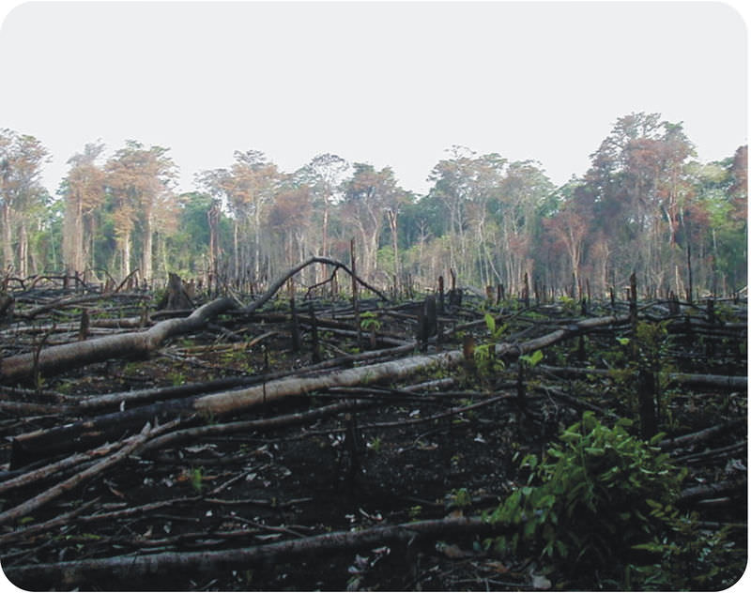
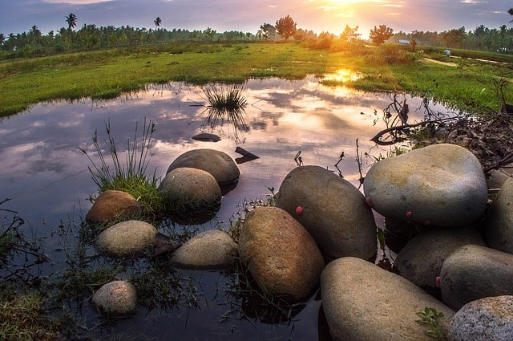

Slide 8
Effects of Habitat Loss on Biodiversity
Habitat loss is a process of environmental change in which a natural habitat is rendered functionally unable to support the species present. This process may be natural or unnatural, and may be caused by habitat fragmentation, geological processes, climate change, or human activities such as the introduction of invasive species or ecosystem nutrient depletion.
In the process of habitat destruction, the organisms that previously used the site are displaced or destroyed, reducing biodiversity.

Slide 9
Endangerment & extinction of species
In extreme cases, the destruction of habitats may also lead to the endangerment or even to the extinction of species. Especially for species that only live in a few different places on our planet, if those areas get destroyed, chances are that those species may become extinct sooner or later.
Ecological imbalance
Ecosystems are quite complex organisms with myriads of interdependencies. If one species becomes extinct, there could be several adverse effects on other predator or prey species.

Slide 10
Destruction of breeding grounds
Floods
Droughts
Erosion
Reduction in crop yields
Spread of pests
Invasive species
Global hunger
Health effects
Higher mortality
Global warming

Slide 11
Conservation of habitat
Reduction in greenhouse gas emissions
One important step to reduce greenhouse gas emissions is the transition from fossil to renewable energy sources, which is already on the agenda of many industrialized countries.
Protection of our oceans
In many countries all over the world, plenty of waste is still disposed into our oceans, which leads to serious ocean pollution and to the destruction of habitats of many animals and plants.
Thus, it is crucial that governments around the world pay close attention to this issue and take measures in order to reduce ocean dumping.

Slide 12
Reduction of the use of fertilizers and pesticides
Since the excessive use of fertilizers and pesticides implies serious soil pollution, which in turn contributes to the destruction of habitats, farmers should reduce their use of those substances in order to preserve natural habitats and also to protect our soil as well as our groundwater.
More nature reserves
In order to preserve our natural habitats in the future, governments around the world should create more nature reserves that should protect our animal and plant species from human interventions like mining or other practices that could potentially harm our environment.

Slide 13
Stop deforestation
Since our forests, especially our tropical rainforests, are natural habitats of the majority of all animal and plant species on our planet, it is crucial to stop deforestation and therefore to preserve those precious natural ecosystems. Only then will we be able to sustain biodiversity and ensure the natural balance of our planet.
Altering of our consumption behavior
Reduction in waste
Population control measures
Education
Raising awareness

Slide 14
Habitat Conservation
Habitat conservation is a land management practice that seeks to conserve, protect and restore, habitat areas for wild plants and animals, especially conservation reliant species, and prevent their extinction, fragmentation or reduction in range. (“Habitat Conservation”, 2009).
Habitat conservation is important in maintaining biodiversity, an essential part of global food security. There is evidence to support a trend of accelerating erosion of the genetic resources of agricultural plants and animals (Brooks, 2002).

Slide 15
Habitat conservation is vital for protecting species and ecological processes.
It is important to conserve and protect the space/ area in which that species occupies.
In the United States of America, a Habitat Conservation Plan (HCP) is often developed to conserve the environment in which a specific species inhabits.
Under the U.S. Endangered Species Act (ESA) the habitat that requires protection in an HCP is referred to as the ‘critical habitat’.

Slide 16
Habitat Conservation Plan (HCP)
The number of approved HCPs has grown since the first HCP was created in 1983 for San Bruno Mountain in San Mateo County, California
HCPs require clearly defined goals and objectives, efficient monitoring programs, as well as successful communication and collaboration with stakeholders and land owners in the area.
Reserve design is also important and requires a high level of planning and management in order to achieve the goals of the HCP.

Slide 17
Successful reserve design often takes the form of a hierarchical system with the most valued habitats requiring high protection being surrounded by buffer habitats that have a lower protection status.
Like HCPs, hierarchical reserve design is a method most often used to protect a single species, and as a result habitat corridors are maintained, edge effects are reduced and a broader suite of species are protected.

Slide 18
HCP Development process
Generate a species list
Once the applicant has decided to initiate the development of a HCP, they must identify the species of concern that the HCP will be developed for. All listed animal species that have the potential to be impacted by the proposed action/project must be included in this list.
Habitat-based approach
An alternative method to developing a HCP for target species of concern is to develop a HCP for a particular habitat type. All species considered within the habitat-based HCP may be included under the Incidental Take Permit. The benefit of developing a habitat-based HCP rather than a species-based HCP is that, if prepared properly, a single HCP would theoretically benefit multiple species or an entire ecosystem rather than only protecting the species listed under the ESA.

Slide 19
Define geographic boundaries
Once the target species or habitat type to be considered in the HCP have been identified, the geographic boundaries of the planning area need to be established. It is important to be precise when defining the land area to which the HCP will apply, with regards to impacts associated with the proposed action, to circumvent potential problems in later phases of the development process.
Gather biological data
After delineating the boundaries of the HCP area and the species within that area to be included in the HCP, current biological information for each of those species must be obtained. Data pertaining to the species' ecology, geographical distribution, and occurrence is required and may be available from existing sources. If existing information is not available or sufficient for the requirements of the HCP, biological studies must be completed to supplement this requirement.

Slide 20
Develop a mitigation program
Common mitigation measures often include the following:^{[3]}
Avoid the impact
Minimize the impact
Rectify the impact
Reduce/eliminate the impact over time
Compensate for the impact

Slide 21
Avoidance
The avoidance of ecological impacts by not developing the proposed infrastructure may be the only solution to avoid fragmentation of vulnerable habitats. Adapting the alignment of the infrastructure to avoid bisecting vulnerable habitats, reducing the landtake of the road corridor or reducing disturbance to adjacent habitats minimise the impact but do not entirely avoid fragmentation. Avoidance of habitat loss should become the first principle applied in the:
Planning, design, construction and maintenance phases of infrastructure as well as the upgrading or closing of existing roads and railways.
Wider involvement of interest groups, and collation of relevant data in the scoping stages of the EIA/SEA process.
Co-operation between the relevant authorities and organisations.
Commitment to an integrated multidisciplinary approach within the planning framework where all affected interests are taken into account in the assessment of development plans

Slide 22
Mitigation
The barrier effect of transport infrastructure can be mitigated by employing different kinds of measures, such as over- and underpasses aimed at maintaining landscape permeability through the use of animal crossing structures or adapting engineering works to act as fauna passages. The key questions related to mitigation measures are:
1) what is the problem and where is it located;
2) what kind of measures are appropiate to solve it;
3) what design is fit for the purpose?

Slide 23
Compensation
When habitat fragmentation is unavoidable and mitigation measures are unable to compensate for the loss, damage or degradation of habitat, then compensation in the form of habitat creation may be the appropriate response to achieve ‘no net loss’ because of infrastructure development plans
The habitat creation scheme aims to provide additional habitat of appropiate quality and type to compensate for that lost or damaged by infrastructure development

Slide 24
Monitoring
For all these approaches (avoidance, mitigation, compensation) adopted measures should be checked to ensure they conform to design and quality standards and that they work

Slide 25
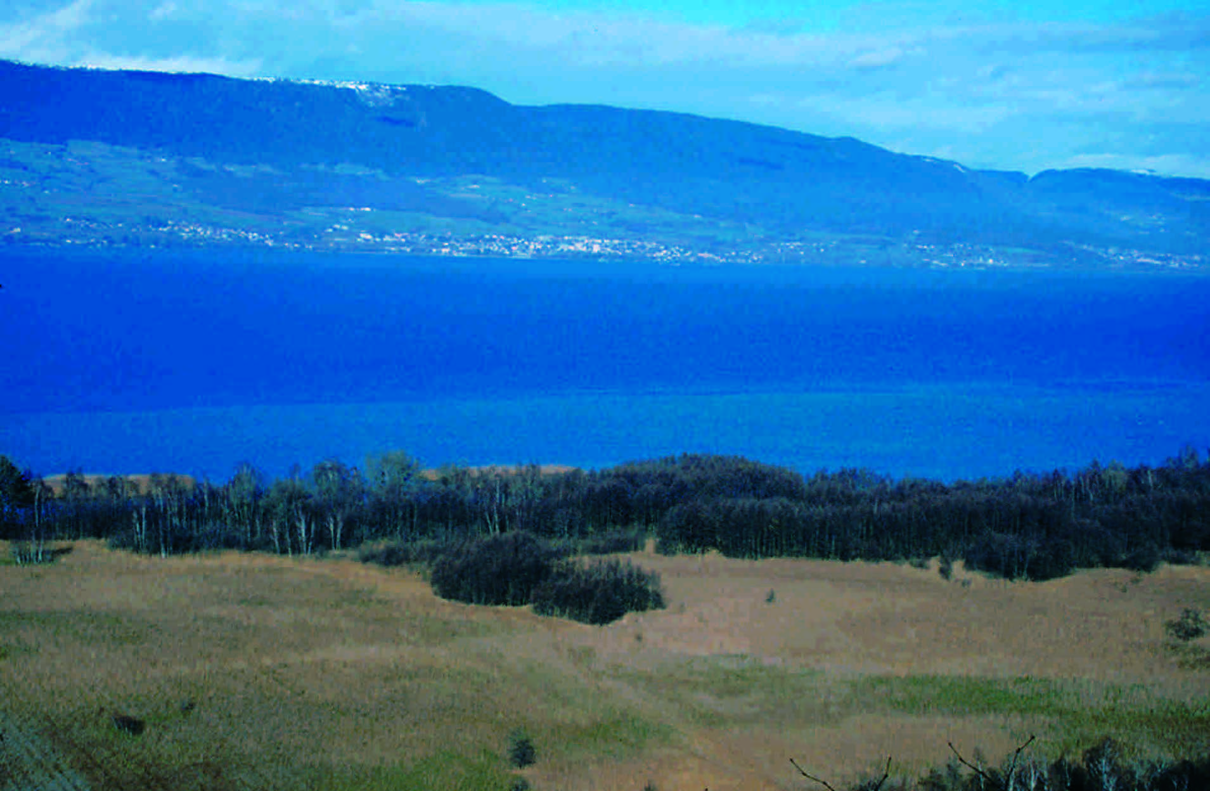

Slide 26
Example: Small-scale HCP
Measures for the 5,856 ft² project included no development on the land where the spineflower is located and elimination of non-native plants growth on the land to prevent competition
Example: Large-scale HCP
Alternatively, the large-scale HCP created for 269,769 acres of the Headwaters Forest in Northern California near Eureka dealt with the largest old-growth redwood ecosystem in the United States. The threatened northern spotted owl (Strix occidentalis caurina) and marbled murrelet (Brachyramphus marmoratus) rely on the large redwoods for nesting as well as the threatened coho salmon (Oncorhynchus kisutch), who are dependent on the habitat's stream for spawning

Slide 27
Current conservation organizations
The Nature Conservancy
Since its formation in 1951 The Nature Conservancy has slowly developed into one of the world's largest conservation organizations. Currently operating in over 30 countries, across five continents worldwide, The Nature Conservancy aims to protect nature and its assets for future generations.
The Nature Conservancy currently has a large number of diverse projects in operation. They work with countries around the world to protect forests, river systems, oceans, deserts and grasslands. In all cases the aim is to provide a sustainable environment for both the plant and animal life forms that depend on them as well as all future generations to come.turtles

Slide 28
World Wildlife Fund (WWF)
The World Wildlife Fund (WWF) was first formed in after a group of passionate conservationists signed what is now referred to as the Morges Manifesto. WWF is currently operating in over 100 countries across 5 continents with a current listing of over 5 million supporters. One of the first projects of WWF was assisting in the creation of the Charles Darwin Research Foundation which aided in the protection of diverse range of unique species existing on the Galápagos’ Islands, Ecuador.
Countries currently participating include Madagascar, the first country to participate which since 1989 has generated over $US50 million towards preservation, Bolivia, Costa Rica, Ecuador, Gabon, the Philippines and Zambia.

Slide 29
Rare Conservation
Rare has been in operation since 1973 with current global partners in over 50 countries and offices in the United States of America, Mexico, the Philippines, China and Indonesia. Rare focuses on the human activity that threatens biodiversity and habitats such as overfishing and unsustainable agriculture.
In the Southeast Asia's "coral triangle" Rare is training fishers in local communities to better manage the areas around the coral reefs in order to lessen human impact. Such programs last for three years with the aim of changing community attitudes so as to conserve fragile habitats and provide ecological protection for years to come.

Slide 30
WWF Netherlands
WWF Netherlands, along with ARK Nature, Wild Wonders of Europe and Conservation Capital have started the Rewilding Europe project. This project intents to rewild several areas in Europe

Slide 31
Thank You

