Slide 1
Sensation and Perception

Slide 2
Defining Sensation and Perception
Sensation
Input of sensory information
Process of receiving, converting, and transmitting information from the outside world
It occurs when energy in the external environment or the body stimulates receptors in the sense organs.
Perception
The process by which the brain organizes and interprets sensory information.

Slide 3
Sensation & Perception Processes
Notes:
Figure 3.Davis 2 from:
Kassin, S. (1998). Psychology, second edition. Upper Saddle River, NJ: Prentice Hall.

Slide 4
Absolute Threshold
The smallest quantity of physical energy that can be reliably detected by an observer.
Difference threshold
The smallest difference in stimulation that can be reliably detected by an observer when two stimuli are compared.

Slide 5
Absolute Sensory Thresholds
Vision:
A single candle flame from 30 miles on a dark, clear night
Hearing:
The tick of a watch from 20 feet in total quiet
Smell:
1 drop of perfume in a 6-room apartment
Touch:
The wing of a bee on your cheek, dropped from 1 cm
Taste:
1 tsp. Sugar in 2 gal. water

Slide 6
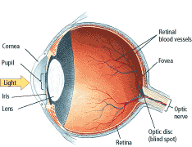
Vision
The eye captures light and focuses it on the visual receptors, which convert light energy to neural impulses sent to the brain

Slide 7
Hearing
Audition (hearing) occurs via sound waves, which result from rapid changes in air pressure caused by vibrating objects
Receptors located in the inner ear (cochlea) tiny hair cells that convert sound energy to neural impulses sent along to brain

Slide 8
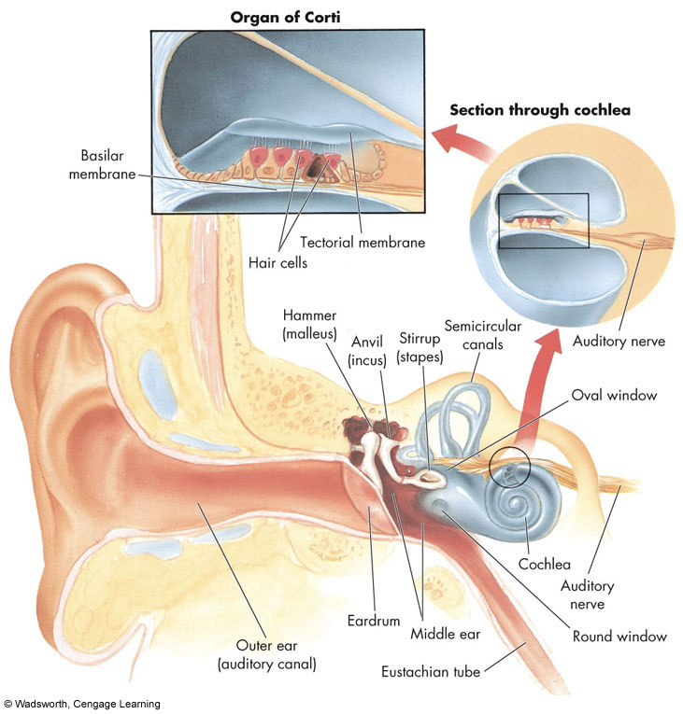
An Ear on the World

Slide 9
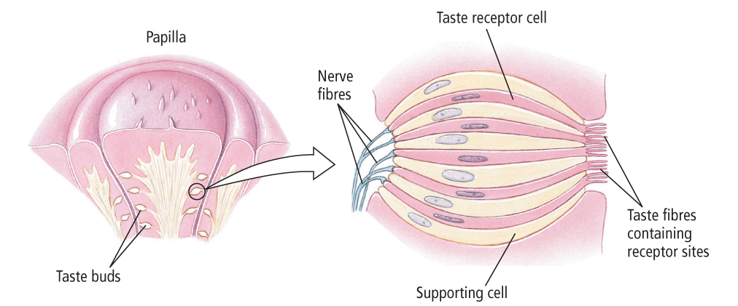
Taste: Savoury Sensations
Gustation - (taste) receptors are taste buds on tongue. Four basic tastes: sweet, salty, sour and bitter

Slide 10
Smell: The Sense of Scents
Airborne chemical molecules enter the nose and circulate through the nasal cavity.
Receptors at the top of the nasal cavity detect these molecules.

Slide 11
Sensitivity to Touch
Vestibular sense (sense of balance) results from receptors in inner ear
Kinesthesis - (body posture, orientation, and body movement) results from receptors in muscles, joint and tendons
Skin senses detect touch (pressure, temperature and pain)
Notes:
Figure 3.18 from:
Kassin, S. (1998). Psychology, second edition. Upper Saddle River, NJ: Prentice Hall.

Slide 12
Perception
Perception refers to interpretation of what we take in through our senses. The way we perceive our environment is what makes us different from other animals and different from each other
I.E. How perception is influenced by a person's experiences, motives, expectations, and goals.

Slide 13
Principles of perception
Gestalt psychologist believed that the whole is different from the sum of its parts. In other words, the brain creates a perception that is more than simply the sum of available sensory inputs, and it does so in predictable ways. Gestalt psychologists translated these predictable ways into principles by which we organize sensory information. As a result, gestalt psychology has been extremely influential in the area of sensation and perception.

Slide 14
Gestalt principles such as figure-ground relationship, grouping by proximity or similarity, the law of good continuation, and closure are all used to help explain how we organize sensory information. Our perceptions are not infallible, and they can be influenced by bias, prejudice, and other factors

Slide 15
Figure-ground relationship.
According to this principle, we tend to segment our visual world into figure and ground. Figure is the object or person that is the focus of the visual field, while the ground is the background

Slide 16
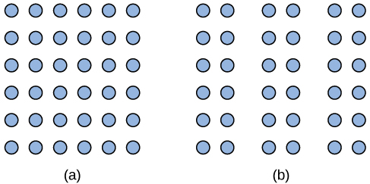
Proximity
Another gestalt principle for organizing sensory stimuli into meaningful perception is proximity. This principle asserts that things that are close to one another tend to be grouped together

Slide 17
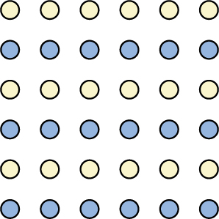
Similarity
According to this principle, things that are alike tend to be grouped together is similarity. For example, when watching a football game, we tend to group individuals based on the colors of their uniforms. We can get a sense of the two teams simply by grouping along this dimension.
When looking at this array of dots, we likely perceive alternating rows of colors. We are grouping these dots according to the principle of similarity.

Slide 18
Law of continuity
The law of continuity suggests that we are more likely to perceive continuous, smooth flowing lines rather than jagged, broken lines

Slide 19
Principle of closure
The principle of closure states that we organize our perceptions into complete objects rather than as a series of parts

Slide 20
According to Gestalt theorists, pattern perception, or our ability to discriminate among different figures and shapes, occurs by following the principles described above. You probably feel fairly certain that your perception accurately matches the real world,
Perception is a complex process. Built from sensations, but influenced by our own experiences, biases, prejudices, and cultures, perceptions can be very different from person to person

Slide 21
Role of perception in human cognition
Perception refers to the ability of the mind to apprehend objects through the sensory modalities of sight, hearing, smell touch and taste while cognition is the thinking about the perceptions in terms of individual previous experience. Hence cognitive process may entail the recall of previous experience or the evaluation of the objects perceived

