Slide 1
Red Rot of Sugarcane:
Dr. Salman Ahmad
April 6, 2020

Slide 2
Description:
One of the oldest & widely distributed in Punjab & Sindh

Slide 3
History and Importance:
First reported from Java in 1883
In sub-continent in 1906

Slide 4
Etiology:
Causal organism: Colletotrichum falcatum
Order: Melanconiales
Family: Melanconiaceae

Slide 5
Symptoms:
Yellowing and dropping of 3rd or 4th leaf from the top
Midrib of leaves is also affected producing red patches with ash colored center having abundant fungal growth.
Infected canes are lighter in weight and are easily broken.
If split open longitudinally especially when withering of leaves starts, pith is found reddened.

Slide 6
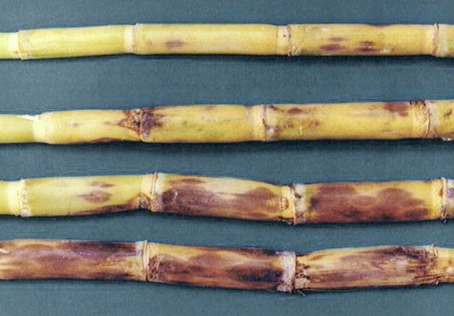
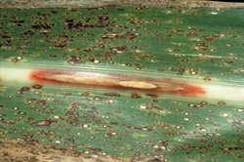
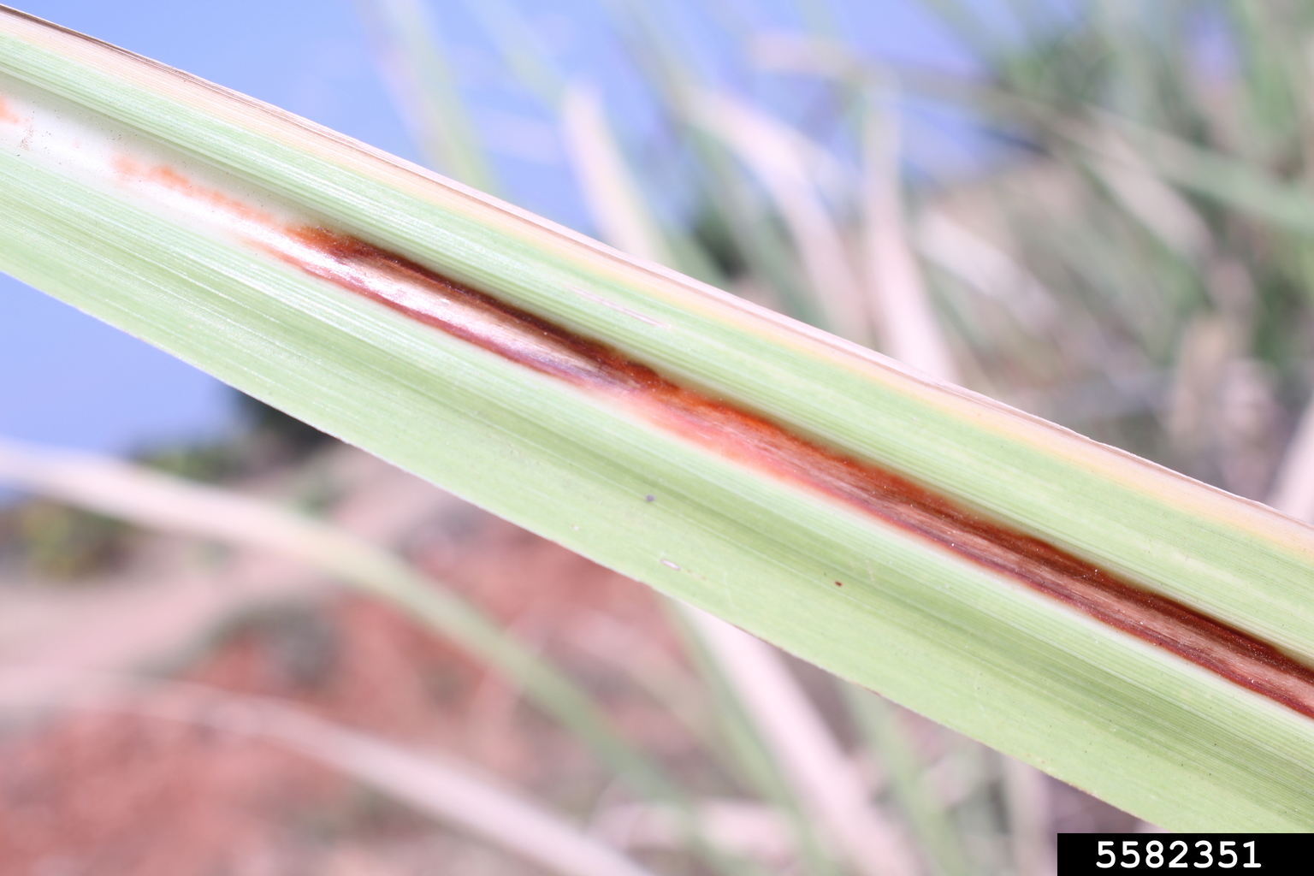
Symptoms:
Red rot in the canes Red rot outside the cane Leaf midrib infected sugarcane leaf midrib
infected

Slide 7
Disease cycle:
Fungus survive in soil & on planting material
Ratoon*( cutting most of the above-ground portion but leaving the roots and the growing shoot apices*(growing points) intact so as to allow the plants to recover and produce a fresh crop in the next season) crop may also help in disease development
Rain, irrigation water, wind & insects also spread the disease

Slide 8
Epidemiology:
27-30°C & High RH
Humid and warm weather, water logged conditions, lack of proper cultural operations resulting in weeds, continuous cultivation of same variety in a particular locality and presence of susceptible varieties in the vicinity are the main factors determining the epidemic development of the disease.

Slide 9
Management:
Crop rotation for two years
Seed setts should be free from disease or treated with solution of Benelat for 1 hr
Residues should be burnt after harvest
Ratoon crop discouraged if first crop infected
Resistant thick canes varieties, particularly e.g. CP-77-400, SPF-24O, 237, CPF 72-2O86 etc.
Treat sets with Formaline solution (1:20), or Benomyl, for10-15 minutes and cover them with wet gunny bags for 3 hours.

