Slide 1
DR.HAROON-UR-RASHID
ASSISTATN PROFESSOR
RADIOTHERAPY & oncology
SARGODHA MEDICAL COLLEGE
DHQ TEACHING HOSPITAL SARGODHA

Slide 2
Overview Treatment of Cancer

Slide 3
What is Cancer
Cancer develops when cells in a part of the body begin to grow out of control. Although there are many kinds of cancer, they all start because of out-of-control growth of abnormal cells.
Normal body cells grow, divide, and die in an orderly fashion. During the early years of a person's life, normal cells divide more rapidly until the person becomes an adult. After that, cells in most parts of the body divide only to replace worn-out or dying cells and to repair injuries.
Because cancer cells continue to grow and divide, they are different from normal cells. Instead of dying, they outlive normal cells and continue to form new abnormal cells.
Notes:
Cancer cells develop because of damage to DNA. This substance is in every cell and directs all its activities. Most of the time when DNA becomes damaged the body is able to repair it. In cancer cells, the damaged DNA is not repaired

Slide 4
Causes of Cancer: General Etiology

Slide 5
Genetic Lesions in Tumors
Activating or inactivating
Somatic or germ line
Genetic targets (oncogenes, tumor suppressor genes, mismatch repair genes) Gene deletions / amplifications
Mutations
Insertional
Point Mutations
Genetic Instability
Chromosomal Instability (CIN)

Slide 6
Alterations of Specific Cellular Functions in Cancer
Tumor Suppressor Genes
Inactivation
Differentiation /Proliferation
CANCER

Slide 7
Hallmarks of Cancer Cells
Self-maintained replication
Longer survival
Genetic instability
Capable of inducing neoangiogenesis
Capable of invasion and metastasis

Slide 8
Environmental Carcinogens
A cancer-causing agent
Three main types:
Chemical
Physical (radiation)
Biological (especially virus)

Slide 9
Chemical Carcinogenesis
Firstly described by Sir Percival Pott in 1775
Chimney sweeps and scrotal cancer
Relationship between occupational exposure to
chimney soot and scrotal carcinoma was established.
Direct-acting Carcinogens
Nitrogen mustard
Nitrosomethylurea
Benzyl chloride

Slide 10
Polycyclic aromatic hydrocarbons (PAH)
Produced by incomplete combustion of organic materials
cigarette smoke

Slide 11
Human carcinogens - environmental
Aflatoxins
Asbestos
Benzene
Cadmium
Coal tar
Creosote
Polycyclic aromatic hydrocarbons
Radon
Solar radiation
Notes:
Solar energy is created at the core of the sun when hydrogen atoms are fused into helium by nuclear fusion.

Slide 12
Human carcinogens - drugs/therapeutic agents
Adriamycin (doxorubicin)
Androgenic steroids
Chlorambucil
Cisplatin
Cyclophosphamide
Cyclosporin A
Melphalan
Tamoxifen

Slide 13
Physical Carcinogens
Ultraviolet light
Ionizing radiation (X-rays)
Asbestos

Slide 15
Skin cancer is one of the most common human cancer and one of the most preventable
BCC and SCC
Most of these will be caused by exposure to ultraviolet (UV) irradiation

Slide 16
Asbestos
Widely used in construction, insulation, and manufacturing
Family of related fibrous silicates
Chrysotile
Crocidolite

Slide 19
Malignant Mesothelioma
Mainly occurs in pleural
and peritoneal cavities
Rare in general population
Latent period of ≥20 years

Slide 20
Ionizing Radiation
Death of pioneer radiation researchers from neoplasms
High incidence of leukemia among radiologists recognized in 1940s
Osteosarcoma incidence in radium dial painters

Slide 22
Viral Carcinogenesis
Viral infections account for an estimated one in seven human cancers worldwide
Majority of these are due to infection with two DNA viruses
HBV - linked to hepatocellular carcinoma
HPV - linked to cervical carcinoma

Slide 23
Oncogenic Viruses
Human papilloma viruses - HPV
Epstein-Barr Virus (EBV)
Human herpes virus 8 (HHV8)
Hepatitis B virus - HBV
Hepatitis C virus - HCV
HTLV-I, HTLV-II

Slide 24
EBV - Involvement in Human Tumors
African Burkitt lymphoma
B-cell lymphomas of immuno suppressed patients
Some cases of Hodgkin lymphoma
Nasopharyngeal carcinomas

Slide 25
Viruses like HPV and HBV Cause Cancer?
Very small viruses
Can integrate their viral DNA into host genome
They code for viral proteins which block tumor suppressor proteins in cells

Slide 26
Helicobacter pylori
Gastric infection linked to gastric lymphomas and adenocarcinomas
Detection of H pylori in majority of cases of gastric lymphomas
Antibiotic treatment results in gastric lymphoma regression in most cases

Slide 27
Treatment of Cancer
Cancerous tumours can be treated using the following main methods:
Surgery.
Radiation therapy (radiotherapy
and brachytherapy).
Chemotherapy (drugs).

Slide 28
Surgery.
The surgeon is often the first specialist to see the patient with a solid malignancy and in the course of therapy.
he or she may be called upon to provide diagnostic, therapeutic, palliative, and supportive care.
In addition, the surgical oncologist must be knowledgeable about all of the available surgical and adjuvant therapies, both standard and experimental, for a particular cancer.
This enables the surgeon not only to explain the various
treatment options to the patient but also to perform the initial steps in diagnosis and treatment.

Slide 29
Invasive diagnostic modalities.
As the surgeon approaches the patient with a solid malignancy or abnormal nodal disease or the rare individual with a tissue-based manifestation of a leukemia, selection of a diagnostic approach that will have a high likelihood of a specific, accurate diagnosis is paramount.
The advent of high-quality invasive diagnostic approaches guided by radiologic imaging modalities has limited the open surgical approach to those situations where the disease is inaccessible, a significant amount of tissue is required for diagnosis.

Slide 30
Lymph node biopsy.
The usual indication for biopsy of the lymph node is to establish the diagnosis of lymphoma or metastatic carcinoma. Each situation should be approached in a different manner.
The goal of biopsy in the patient with an abnormal lymph node and suspected lymphoma is to make the general diagnosis and to establish the lymphoma type and subtype.
The initial diagnosis of lymphoma should be made on a completely excised node that has been minimally manipulated to ensure that there is little crush damage.
When primary lymphoma is suspected, the use of needle aspiration does not consistently allow for the complete analyses described above and can lead to incomplete or inaccurate diagnosis and treatment delays

Slide 31
Carcinoma
The diagnosis of metastatic carcinoma often requires less tissue
than is needed for lymphoma.
Fine-needle aspiration (FNA), core biopsy, or subtotal removal of a single node will be adequate in this situation.
For metastatic disease, the surgeon will use a combination of factors, such as location of the node, physical examination, and symptoms, to predict the site of primary disease.
When this information is communicated to the pathologist, the pathologic evaluation can be focused on the most likely sites so as to obtain the highest diagnostic yield.
The use of immunocyto chemical analyses can be successful in defining the primary site, even on small amounts of tissue.
Mass in the aerodigestive tract .
biopsy of a lesion should include a representative amount of tissue taken preferably from the periphery of the lesion, where the maximum amount of viable malignant cells will be present.
Since the treatment of in situ and invasive disease varies greatly.
Notes:
Malignant neoplasm ihs .lca .cytokeratin.viamentin. Cd. 15 30 20 for lymphoma

Slide 32
Breast mass.
Palpable breast masses that are highly suspicious (as indicated by physical findings and mammography) can be diagnosed as malignant with close to 100% accuracy with FNA.
However, because the distinction between invasive and noninvasive disease is often required prior to the initiation of treatment,
a core biopsy, performed either under image guidance (ultrasonography or mammography) or directly for palpable lesions, is the method of choice.
Notes:
With biopsy Also request for ER PR RECEPTOR her 2neu.

Slide 33
Resection
The principles of resection for malignant disease are based on the surgical goal (complete resection vs debulking), functional significance of the involved organ or structure, and the ability to reconstruct the involved and surrounding structures.
Wide excision
A wide excision includes the removal of the tumor itself and a margin of normal tissue, usually exceeding 1 cm in all directions from the tumor
Notes:
Complete resection such as breast. ca colon,early stage ca tongue.sts low grade. Wide res breast lumpectomy

Slide 34
Principles of radiation therapy.
How radiation works
IONIZING RADIATION is energy sufficiently strong to remove an orbital electron from an atom. This radiation can have an electromagnetic form, such as a high energy photon, or a particulate form, such as an electron, proton, neutron, or alpha particle.

Slide 35
High-energy photons are most common form of radiation used in practice today is the high-energy photon.
Photons that are released from the nucleus of a radioactive atom are known as gamma rays. When photons are created electronically, such as in a clinical linear accelerator, they are known as x-rays.
Thus the only difference between the two terms is the origin of the photon.
The basic unit of radiation absorbed dose is the amount of energy absorbed per unit mass (kg). This unit, known as the gray (Gy),

Slide 36
What is Radiotherapy?
Some history
Advances in radiotherapy
When is it used in cancer treatment?
When is it used in kidney cancer?
Some examples

Slide 37
What is Radiation?
X-rays are
photons, like visible
light, only much
more energetic with a higher frequency and shorter wavelength.
• When high energy
X-rays interact with
matter, they cause
ionization (loss of
electrons from the
orbital of an atom)

Slide 38
How Radiation Works
Radiation causes damage to DNA directly or indirectly
Direct: high energy radiation breaks chemical
bonds, causing damage to DNA (1/3
• Indirect: radiation interaction creates oxygen
free-radicals that damage DNA (2/3)

Slide 40
High energy X-rays
X-rays interact with atoms
Direct DNA damage
Ionisation of water molecules
Cause DNA damage such as ‘Double strand breaks’
Cell ‘suicide’

Slide 42
DNA damage has to be repaired for cell to continue dividing
Normal cells are good at repairing themselves
Cancer cells are not
Cancer cells preferentially killed
Some damage to normal tissues

Slide 43
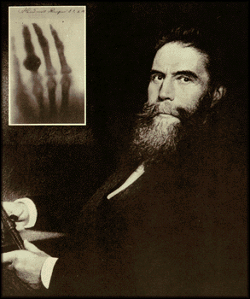
History I
X-rays discovered
1895 (Roentgen)
X-rays used for head and
neck and skin cancers and
benign conditions
e.g. ringworm
Did not penetrate deeply
and high dose on the
skin 1922.
fractionation produce
fewer side effects
Notes:
Unit of xry kv.diagnostic 100-120 kv.superfical xrays.treatmant of benign condition keloid..tineapedis.

Slide 44
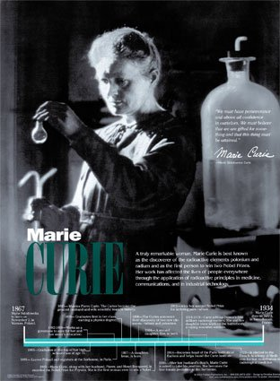
History II
Radium discovered 1898
(Curie): natural radioactive
emitter
Radium used as implants
for cancers of womb and
other sites.

Slide 45
History III
Post 1945: artificially produced radioisotopes became available e.g. radioiodine, cobalt-60 (atomic weapon technology)
1952: First linear accelerator (LINAC) introduced
Magnetron (high power electron source) developed during war for Radar

Slide 46
The Aims of Radiation Therapy
The aim of radiation therapy is to cause damage to the cancerous cells whils minimizing the risk to surrounding healthy tissue.
The damage inflicted by radiation therapy causes the cancerous cells to stop reproducing and thus the tumor shrinks.
Unfortunately, healthy cells can also be damaged by the radiation.

Slide 47
Why does the amount of radiation given to the patient have to be accurately calculated.
The amount of radiation given to the patient has to be accurately calculated so that the damage is limited to the cancerous cells only.

Slide 48
Radiation Therapy
Radiation therapy uses ionising radiation to treat cancer i.e. to destroy cancerous cells.
There are two techniques in radiation therapy that are used to treat cancer using ionising radiation.
Radiotherapy
Brachytherapy
Notes:
Away from pt ssd 80to 100cm.to avoid pair production.brachy low dose.source close contect w pt.

Slide 49
Radiotherapy Treatment Planning
Every treatment using radiotherapy has to be rigorously planned. The planning process consists of four phases.
Planning
Simulation
Tumor dose
Treatment

Slide 50
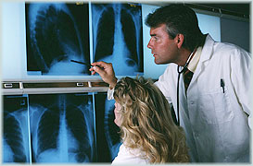
Radiotherapy Treatment Planning
The cancerous tumour has to be located so that its size and position can be analysed. This information can be obtained from:
X-rays
CT scans
MRI scans
Ultrasound images

Slide 51
Radiotherapy Treatment Planning
Simulation
Once the amount of radiation to be given has been accurately calculated, the patient then goes to the simulator to determine what settings are to be selected for the actual treatment using a linear accelerator.
The settings are determined by taking a series of x-rays to make sure that the tumour is in the correct position ready to receive the ionising radiation.

Slide 53
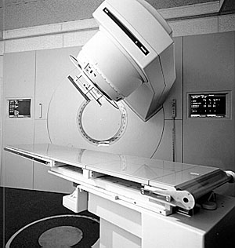
Radiotherapy Treatment Planning Treatment of Cancerous
tumours can be treated
using radiotherapy as
follows:
Irradiation using high
energy gamma rays.
Irradiation using high
energy x-rays.

Slide 54
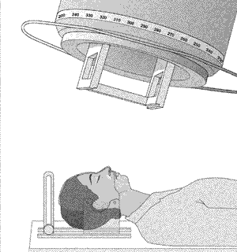
Radiotherapy Treatment Irradiation Using High Energy Gamma Rays
Gamma rays are emitted
from a cobalt-60 source
– a radioactive form of
cobalt.
The cobalt source is
kept within a thick,
heavy metal container.
This container has a
slit in it to allow a narrow
beam of gamma rays to
emerge.
Notes:
Head and neck tharmoplastic mold head necd’ intect breast .to avoid marking and imoblization

Slide 55
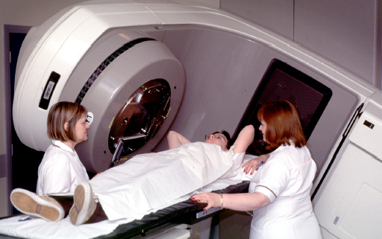
How is radiotherapy given
Linear Accelerator produces XRays
Shaped to the area to be treated ‘field’

Slide 56
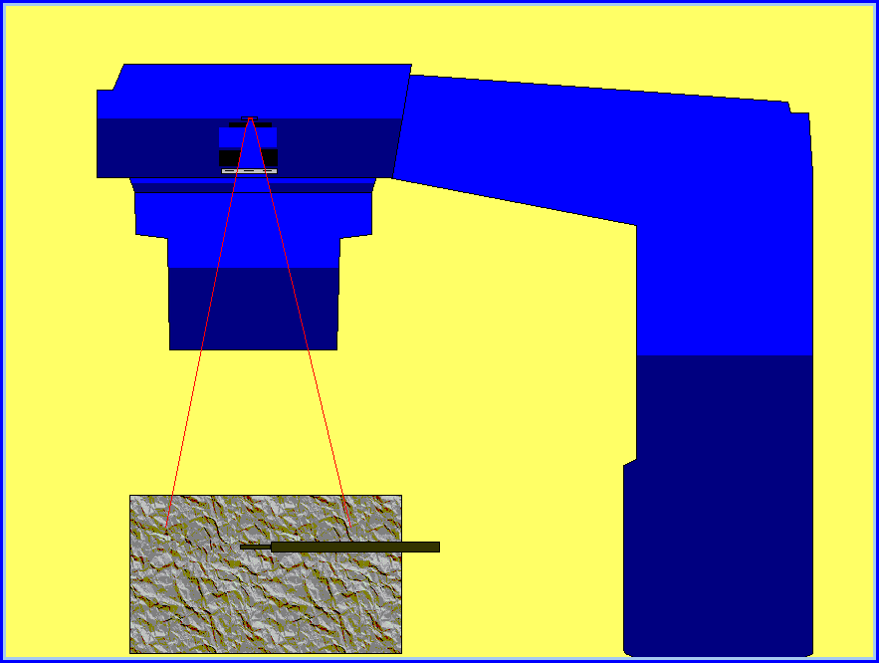
Irradiation Using High Energy X-rays
The x-rays are generated
by a linear accelerator .
The linac fires high energ
electrons at a metal
target and when the
electrons strike the target,
x-rays are produced.
The x-rays produced are
shaped into a narrow beam
by movable metal shutters
Notes:
Elecrtron stike on target made of tungston

Slide 57
Treatment of Cancer Radiotherapy
The apparatus is arranged so
that it can rotate around the
couch on which the patient lies.
This allows the patient to receive
radiation from different directions.
The diseased tissue receives radiation
all of the time but the healthy
tissue receives the minimum
amount of radiation possible.
Treatments are given as a series of
small doses because cancerous cells
are killed more easily when they are
dividing, and not all cells divide at
the same time – this reduces some
of the side effects which come with
radiotherapy.

Slide 58
External Beam Treatment
Most commonly Cobalt 60 γ rays (1.25 MeV), x-rays, electrons
Co 60 radioactive source
x-rays and e⁻, electron linac
Sometimes orthovoltage (up to 300 kV)
Superficial tumours
More rarely hadrons (many MeV)
protons, neutrons, heavy ions

Slide 59
Beam Shaping Devices
Main Rectangular Collimators
Wedge
Multileaf Collimator
Field edge shaping
Block
Compensator
Multileaf Collimator
IMRT (intensity modulated radiotherapy)

Slide 60
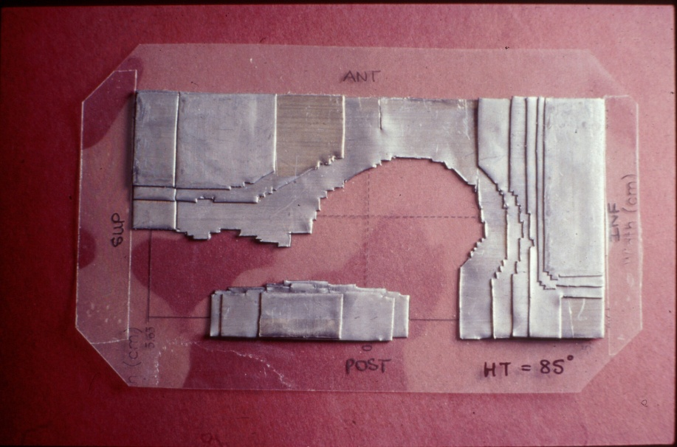
Lead Compensator
Sheets of lead
0.5 mm thick
Used in conjunction with wedge
Shapes to breast and shields lung

Slide 61
Linacs have high energy X-Rays which penetrate deep into body with much lower dose on skin (limiting factor with early X-ray treatments)
Computerisation has revolutionised treatment planning to improve accuracy, spare normal tissues and increase dose to tumour

Slide 62
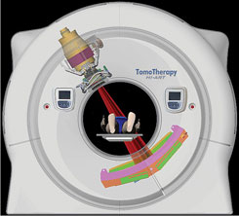
Tomotherapy
Combines CT and Linac
RT delivered in multiple
spiral fields
Allows very accurate
dose delivery
Daily real time CT
imaging high accuracy

Slide 63
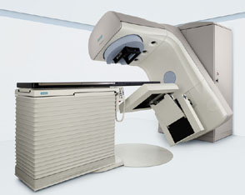

Slide 65
Standard treatments
Conventional planning and Linac treatment highly accurate
Sufficient for most treatments

Slide 66
Use of Radiotherapy in Cancer treatment
Radiotherapy
Local treatment
Early and late stage

Slide 67
Curative Role
Head and Neck Ca
Ca Cervix
Anal and skin Ca
Prostate Ca
Bladder Ca
Early Lung Ca
Early Ca Oesophagus
Seminoma
Hodgkin’s disease and NHL
Medulloblastomas and some brain tumours

Slide 68
Component of Multimodality Curative Treatment
Breast Ca
Rectal Ca
Advanced Head and Neck Ca
Advanced Lung Ca
Advanced Oesophageal Ca
Pancreatic Ca
Sarcomas

Slide 69
Benefits of Radiotherapy
Breast Cancer
Mastectomy
Compare surgery and chemotherapy (CMF) with and without radiotherapy
10 year survival improvement at 10 years

Slide 71
Sites for radiotherapy
Anywhere!
Bone
Spine
Soft tissue
Lymph nodes
Brain
Lung
Combined with surgery in some cases

Slide 72
radiotherapy treatments given to patients with bone or ‘soft tissue’ secondary cancers
Response rate (improvement in symptoms or scans) in those reassessed after treatment was 85%

Slide 73
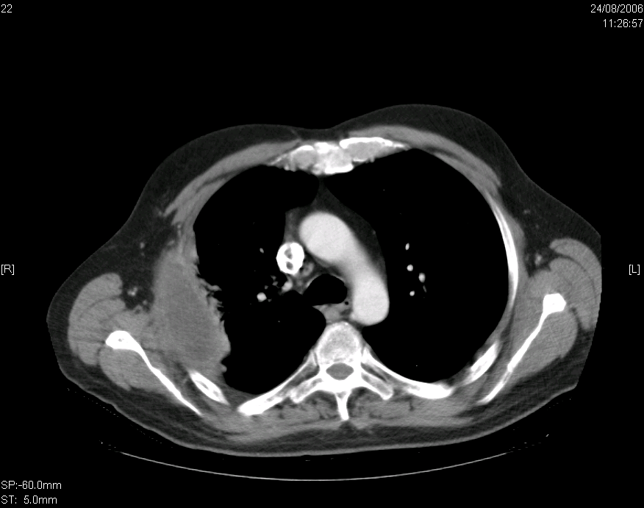
Soft tissue chest wall

Slide 74
After RT and TKIs (4 years later….)

Slide 75
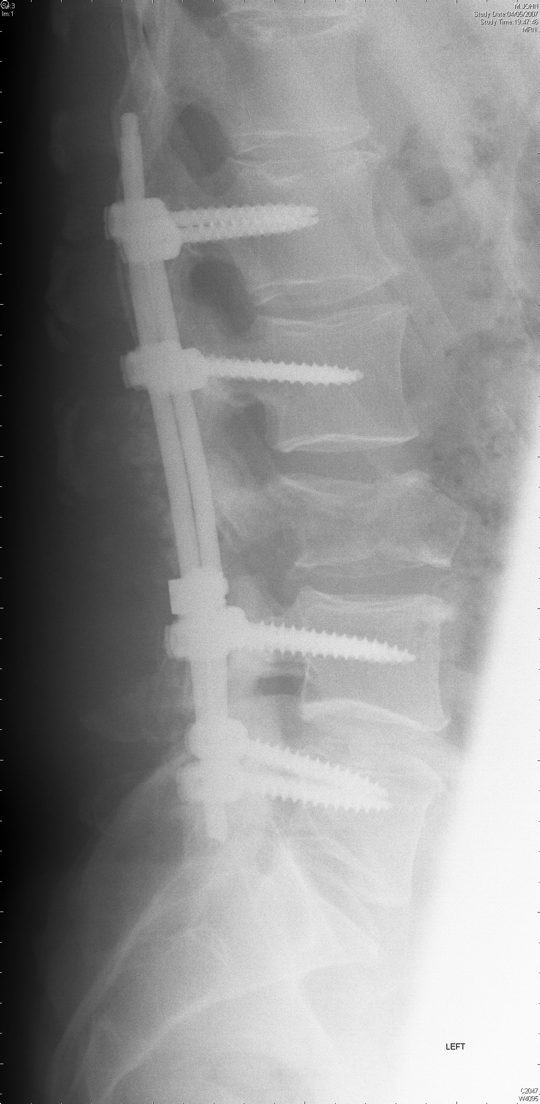

Slide 76
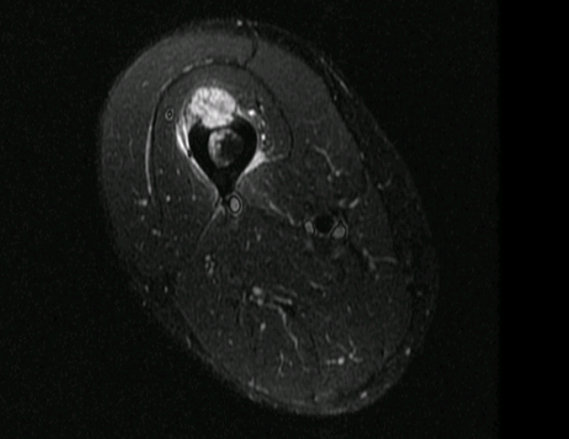

Slide 77
Brachytherapy
This involves placing implants in the form of seeds, wires or pellets directly into the tumour.
Such implants may be temporary or permanent depending on the implant and the tumour itself.
The benefit of such a method is that the tumour receives nearly all of the dose whilst healthy tissue hardly receives any.

Slide 78
Brachytherapy
Sources placed in patient using metal tubes or applicators
e.g. Ir¹⁹²
High dose rate (HDR) and low dose rate (LDR), pulsed dose rate (PDR)
Fractionated
Prescription schemes for location of sources
Notes:
Cs137 in low dose rate mostly used

Slide 79
High Dose Rate (HDR) Brachytherapy
Interstitial multi catheter technique
Original breast
brachytherpy technique Performed after lumpectomy
Catheters are inserted under ultrasound or CT guidance around the lumpectomy site

Slide 80
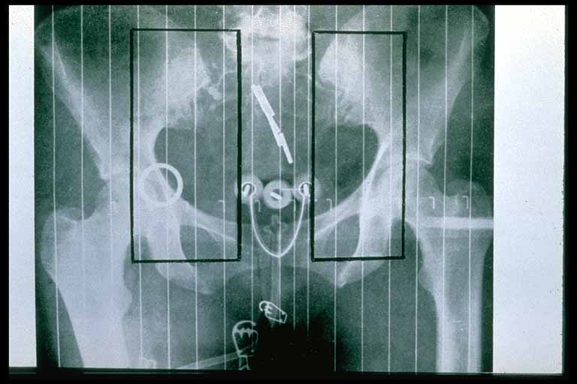
Brachytherapy is used to treat the following cancers:
Uterus
Cervix
Prostate
Intraocular
Skin
Thyroid
Bone

Slide 85
Side Effects of RT
Epidermal layers of skin, GIT - fast turnover
Thus RT kills the epidermal layers as they go into mitosis
Lower layers insufficient time to repopulate
Thus de-sloughing occurs :-
- skin : erythema, dry then moist desquamation “sun burn”
- mucosa : mucositis, oesophagitis, gastritis, colitis proctitis, cystitis
- marrow : pan- cytopaenia

Slide 86
Side Effects of RT
Xerostomia
From day 1
- Pilocarpine 5-10mg tid
- Saliva sustitutes (oral balance)
- Ethyol (amifostine)
- (Risk of tumour protection)
Serous component of saliva affected most often
- Bicarbonate mouth rinses

Slide 87
Side Effects of RT
Mucositis
direct mucosal (basal layer) damage
secondary infection
good oral hygiene
Anti -fungals
pain killers, steroids
lidocaine
soft diet
avoid spices, smokes, spirits

Slide 88
Skin Reactions
Erythema
Dry desquamation (peeling)
hydrocortisone 1%
Moist desquamation (dermis exposed )
gentian violet
paraminol cream
healing within 2-4 weeks after RT
Sialadenitis
5% develop it within 12 hrs of 1st RT
transient painless enlargement of salivary gland
usually disappears within a week despite continuation of treatment

Slide 89
RT induced 2nd Malignancies
RT induced Mucosal CA
RT Induced Sarcoma
RT Induced Thyroid Ca
Carcimoma breast
Leukemia
Lymphoma
Skin cancer
Notes:
After rt in hodgkin cause breast

Slide 90
Sterilisation
Radiation not only kills cells, it can also kill germs or bacteria.
Nowadays, medical instruments (e.g. syringes) are prepacked and then irradiation using an intense gamma ray source.
This kills any germs or bacteria but does not damage the syringe, nor make it radioactive.

Slide 91
Summary
Ionising radiation is used in radiotherapy to treat cancer and to sterilise medical equipment because it destroys cells.
Radioactive tracers are used in nuclear medicine because the ionising radiation it emits is easy to detect.

Slide 92
Summary
There are 3 main uses of ionising radiation in medicine: treatment, diagnosis and sterilisation.
Radiotherapy is used to treat cancers by irradiating them with ionising radiation.
Radioactive tracers are used to diagnose and investigate several medical conditions.
Ionising radiation is used to sterilise medical equipment as it kills germs and/or bacteria
Notes:
Tc99 Like bone scan .renal scan. thelium scan

Slide 93
Chemotherapy

Slide 94
Cytotoxic Chemotherapy
Cytotoxic literally translated means ‘toxic to cells’. Hence these drugs are those which kill cells.
Chemotherapy - the treatment of disease by the use of chemical substances

Slide 95
BASIC PRINCIPLES
Prevents cancer cells from multiplying, invading, metastasising and killing patient.
Affects cell multiplication and tumour growth.
Especially affects cells with a rapid rate of turnover.
Effectively given - marked effect and minimal toxicity.

Slide 96
Chemotherapy is a common treatment for a variety of cancers.
It has proven to be safe and
effective.

Slide 97
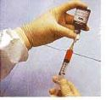
An understanding of this treatment
helps patients better
recognize and Tolerate
side effects, if they
occur.

Slide 98
CHEMOTHERAPY
Antineoplastic agents are used in an attempt to destroy tumor cells by interfering with cellular functions including replication
Chemotherapy is used primarily to treat systemic disease rather than localized lesions that are amenable to surgery or radiation

Slide 99
How Does Chemotherapy Works?

Slide 100
To understand how chemotherapy works as a treatment, it is helpful to understand the normal life cycle of a cell in the body.
All living tissue is composed of cells. Cells grow and reproduce to replace cells lost during injury or normal "wear and tear." The cell cycle is a series of steps that both normal cells and cancer cells go through in order to form new cells.

Slide 101
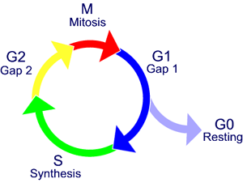
The cell cycle phases are:
resting (G0; nothing is happening),
G1 (or gap 1; a growth phase),
S (synthesis; the replication of DNA occurs),
G2 (gap 2; another growth phase),
M (mitosis; the actual division
from 1 cell into 2).

Slide 102
The Cell Cycle
G0 phase (resting stage): The cell has not yet started to divide. Cells spend much of their lives in this phase. Depending on the type of cell, G0 can last for a few hours to a few years. When the cell is signaled to reproduce, it moves into the G1 phase.
G1 phase: During this phase, the cell starts making more proteins and growing larger, so the new cells will be of normal size. This phase lasts about 18 to 30 hours.

Slide 103
S phase: In the S phase, the chromosomes containing the genetic code (DNA) are copied so that both of the new cells formed will have matching strands of DNA. This phase lasts about 18 to 20 hours.
G2 phase: In the G2 phase, the cell checks the DNA and prepares to start splitting into 2 cells. It lasts from 2 to 10 hours.
M phase (mitosis): In this phase, which lasts only 30 to 60 minutes, the cell actually splits into 2 new cells.

Slide 104
CELL CYCLE SPECIFIC VERSUS NON-SPECIFIC
Certain chemotherapy drugs require cells to be in cycle for activity (i.e. not resting).
Cell Cycle specific - most active against cells in a specific phase therefore need prolonged exposure or repeated doses.
Cell Cycle Non-specific - most effective against actively dividing cells but also effective in G0.

Slide 107
DOSE AND SCHEDULE
Aim to maximise dose while minimising toxicity
Only a proportion of cells die within given treatment therefore repeated doses are used.
prolonged exposure e.g. continuous infusion.
dose dependant but toxicity increased.

Slide 108
COMBINATION THERAPY
Reduces resistance to drugs
Increased effectiveness
Access to sites e.g. lungs, CSF.
Combinations selected to avoid overlapping toxicity but:
Causes spectrum of adverse effects but minimises risk of lethal effects.

Slide 109
Advantages of combination therapy Combinations of agents with differing toxicities & mechanisms of action are often employed to overcome the limited cell kill of individual anti cancer agents. Each drug selected should be effective alone
1. Suppression of drug resistance - less chance of a cell developing resistance to 2 drugs than to 1 drug.
2. Increased cancer cell kill - administration of drugs with different mechanisms of action.
3. Reduced injury to normal cells - by using a combination of drugs that do not have overlapping toxicities, we can achieve a greater anticancer effect than we could by using any one agent alone

Slide 110
According to the log-kill hypothesis, chemotherapeutic agents kill a constant fraction of cells (first order kinetics), rather than a specific number of cells, after each dose
1. Solid cancer tumors - generally have a low growth fraction thus respond poorly to chemotherapy & in most cases need to be removed by surgery
2. Disseminated cancers- generally have a high growth fraction & generally respond well to chemotherapy

Slide 111
General problems with anticancer drugs
Most of them are antiproliferative, i.e. they damage DNA and so initiate apoptosis.
They also affect rapidly dividing normal cells.
This leads to toxicity which are usually severe.
To greater or lesser extent the following toxicities are exhibits by all anticancer drugs.

Slide 112
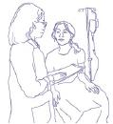
How is chemotherapy given?
How is chemotherapy given?

Slide 115
Orally (by mouth, in pill form)
Intravenously (IV, through a vein, either as a short infusion or continuously for one or more days)
As an injection or needle
Directly into a body cavity (i.e.: the bladder, abdominal cavity)
Intra-arterially (in special cases, such as HCC )

Slide 116
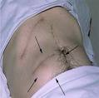
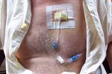

Slide 117
Sequence of treatments:
Adjuvant therapy:
therapy given after surgery to reduce the likelihood of the cancer returning. Adjuvant chemotherapy may be given with potentially curative treatment e.g. Ca Breast.
Neo-adjuvant therapy: therapy given before surgery to shrink the tumor, allowing the surgery to be more successful.
Concurrent therapy: when 2 or more therapies are given together, such as chemotherapy and radiation.

Slide 118
Induction chemotherapy.
Chemotherpy given to induce a remission.
Consolidation chemotherapy.
Chemotherapy given once a remission is achived to sustain a remission.
Maintenance chemotherapy.
chemotherapy given after an initial chemotherapy course to prolong a response
Palliative chemotheray. Symptom Control i.e. pain control when previous therapy has failed or disease has relapsed.

Slide 119
Treatment with drugs that kill cancer cells (or make them less active)
Interfering with tumour cells ability to grow and proliferate
Adjuvant chemotherapy ie localized breast cancer
Induction chemotherapy ie AML & ALL
Curative chemotherapy ie Diffuse Large B Cell Lymphoma
Palliative chemotherapy

Slide 120
What are the side effects of chemotherapy

Slide 121
SKIN
Alopecia
Hair loss occurs because chemotherapy can sometimes damage healthy cells.
It is so common because hair follicle cells multiply very quickly like cancer cells and chemotherapy drugs have difficulty in discerning the difference.

Slide 124
GASTROINTESTINAL SYSTEM
can cause irritation which can eventually lead to inflammation of the mouth, a condition known as stomatitis .
A stinging sensation in the throat may develop and lead to dysphagia (difficulty in swallowing).
Management:
Good oral hygiene

Slide 125
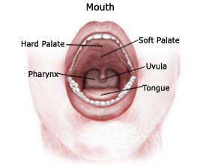
Nausea & Vomiting- most common side effects of chemotherapy and may persist for as long as 24-48 hrs. after its administration.
Mucositis – inflammation of the
mucosal lining

Slide 126
Diarrhea can also be a side effect of chemotherapy. Caused by the destruction of normal, dividing cells of the gastrointestinal (GI) tract, diarrhea varies from patient to patient. It is better managed if treated early
RENAL SYSTEM
Rapid tumor cell lysis- increased urinary excretion of uric acid, which can cause renal damage

Slide 127
HEMATOPOIETIC SYSTEM
Myelosuppression- depression of bone marrow function, resulting in decreased production of blood cells.
Decreases the number of RBCs (anemia), WBCs (leukopenia) and platelets (thrombocytopenia
pancytopenia

Slide 128
Colony-stimulating factor:
G-CSF (granulocyte-colony stimulating factor)
GM-CSF (granulocyte macrophage colony-stimulating factor)
EPO (erythropoietin)

Slide 129
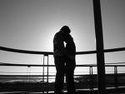
REPRODUCTIVE SYSTEM
take effective contraceptive
Precautions when having
chemotherapy, as the chemotherapy
drugs might harm the baby if
pregnancy occurs. In some
women, chemotherapy brings
on an early menopause. This may
cause symptoms such as dryness
of the vagina and a decreased
interest in sex.

Slide 130
NEUROLOGIC SYSTEM
Peripheral neuropathies
Loss of deep tendon reflexes
Paralytic ileus
Very common with vincristine, vinblastine, cisplatin
Usually temporary.
Sometimes leads to dose alterations or stopping of some drugs
MISCELLANEOUS
Fatigue

Slide 131
Nursing Management in Chemotherapy

Slide 132
Assess fluid and electrolyte status
(Anorexia, nausea & vomiting, altered taste and diarrhea put patient at risk)
Modifying risk for infection and bleeding
(suppression of the bone marrow and immune system)

Slide 133
Administering Chemotherapy
- patient is observed for extravasation (particularly of vesicant agents, which may produce necrosis if deposited in subcutaneous tissues
Protect measure.
Proper dispose off

Slide 134
SAFE HANDLING
Essential to reduce risks to involved personnel.
Cytotoxic drugs are carcinogenic, mutagenic and teratogenic.

Slide 135
Potential exposure to staff occurs during:
preparation
administration and changing lines etc
handling of body fluids e.g urine
handling of chemo waste products e.g lines, medication bottles
spillage / leakage of chemotherapy
transportation

Slide 136
LATE EFFECTS
Infertility
Secondary malignancy
Growth retardation

Slide 137
The potential benefit to the patient of treatment
as an option must always outweigh the toxic effects.

Slide 138
Thanks

