Slide 1
Variables and Types of variables

Slide 2
Variable
A characteristics that varies with an individual or an object is called variable.
For example :
Age, weight and blood pressure.

Slide 3
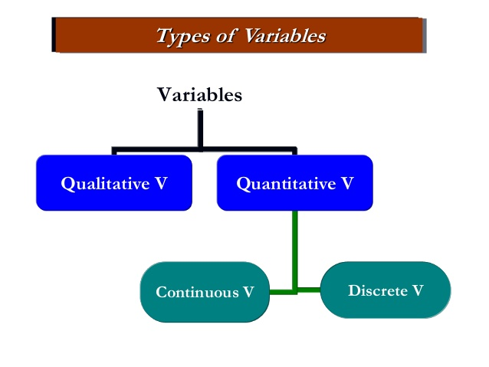
Types of variables

Slide 4
Quantitative variable
A variable is called a quantitative variable when a characteristics can be expressed numerically.
For example:
Income ,number of stars , &number of children.

Slide 5
Qualitative Variable
If a characteristics cannot be expressed numerically then it is called qualitative variable . It is also called attribute.
For example:
Gender , eye color hair color and religion

Slide 6
Types of quantitative Variable
There are two types quantitative variable
Discrete variable
Continuous variable

Slide 7
Discrete variable
A discrete variable is one that can take only a discrete set of integers or whole numbers.
For example :
Number of admissions
test questions answered correctly
Number of students in a Class.

Slide 8
Continuous variable
A variable is called a continuous if it can take on any fractional value or integer with in a range or given interval.
For example:
Blood sugar
Height
weight

