Slide 1
Renin Inhibitor
Taseer Ahmad
Lecturer
College of Pharmacy University of Sargodha

Slide 2
RENIN INHIBITOR
A selective renin inhibitor, aliskiren [a-LIS-ke-rin], is available for the treatment of hypertension.
Aliskiren directly inhibits renin and, thus, acts earlier in the renin–angiotensin–aldosterone system than ACE inhibitors
or ARBs (Figure 17.10).
It lowers blood pressure about as effectively asARBs, ACE inhibitors, and thiazides. Aliskiren should not be routinely combined with an ACE inhibitor or ARB. Aliskiren can cause diarrhea,especially at higher doses, and can also cause cough and angioedema,but probably less often than ACE inhibitors.
As with ACE inhibitors and ARBs, aliskiren is contraindicated during pregnancy.

Slide 3
Angiotensin II Receptor Blockers (ARBs)

Slide 4
Losartan, candesartan, valsartan and irbesartan (sartans)are non-peptide
Their pharmacologic effects are similar to those of ACE inhibitors in that they produce arteriolar and venous dilation and block aldosterone secretion, thus lowering blood pressure and decreasing salt and water retention
ARBs do not increase bradykinin levels.

Slide 5
Chymase (which is not inhibited by ACE inhibitors) providing one alternative route.
ARBs should not be combined with an ACE inhibitor for the treatment of hypertension due to similar mechanisms and adverse effects
These agents are also teratogenic and should not be used by pregnant women.

Slide 6
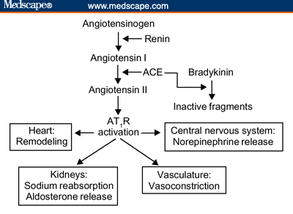

Slide 7
