Slide 1
Informed Search Or Heuristic Search
Lecture 07

Slide 2
Heuristics
Heuristics are formalized as:
Rules for choosing those branches in a state space that are most likely to lead to an acceptable problem solution

Slide 3
Heuristics
Two basic situation for the use of Heuristics:
An inherently ambiguous problem e.g, medical diagnosis system
The cost of finding a solution by exhaustive methods like depth first search, is prohibitive
A heuristic is fallible: it is only an informed guess of next step to be taken in solving a problem
A heuristic can lead a search algorithm to a sub-optimal solution or fail to find any solution.

Slide 4
Tic-Tac-Toe problem solving using Heuristic
Consider the example of state space
9 nodes at the first level 8 nodes of each node at level–2 =9x8x7 . . 2 (9!=326880) nodes to search
Need to reduce the number of nodes or the size of the state space
Analyze carefully the rules of playing Tic-Tac-Toe or view as expert to setup heuristic

Slide 5
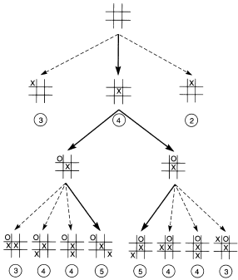
State Space Reduced by Symmetry

Slide 6
Tic-Tac-Toe problem solving using Heuristic
A simple heuristic can eliminate search entirely:
We may move to the board in which “X” has the most winning lines.
In case of states with equal numbers of potential wins, take the first such state found.
In case “X” takes the center of the grid. That will eliminates other alternates along with all of its descendants to 2/3 of the space.

Slide 7
Tic-Tac-Toe problem solving using Heuristic
Heuristics for State Space for TIC-TAC-TOE
X
X
X
3
4
2
Dashed lines shows the number of potential wins at each level-1

Slide 8
Tic-Tac-Toe using Heuristic
X
X
X
3
4
2
O
O
X
X
O
O
O
O
X
X
X
X
X
X
X
X
3
4
4
5

Slide 9
IMPLEMENTING HEURISTIC EVALUATION FUNCTION
8 PUZZLE PROBLEM
Count the tiles out of place
Sum all the distances by which the tiles are out of place

Slide 10
IMPLEMENTING HEURISTIC EVALUATION FUNCTION
a b
5 6
3 4
5 6
2 | 8 | 3
1 | 6 | 4
 | 7 | 5
1 | 2 | 3
8 |  | 4
7 | 6 | 5
2 | 8 | 3
1 |  | 4
7 | 6 | 5
2 | 8 | 3
1 | 6 | 4
7 | 5

Slide 11
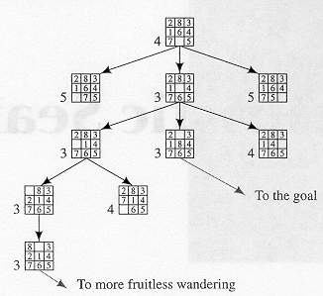
A Possible Result of a Heuristic Search Procedure
No of tiles s that are misplace

Slide 12
HEURISTIC EVALUATION FUNCTION
If two states have same heuristic value it is preferable to pick the state that is near the start state
Thus our evaluation function takes the form
f(n)=g(n) + h(n)
h(n) is the heuristic value of the state n
g(n) is the distance of the state n from the start state

Slide 13
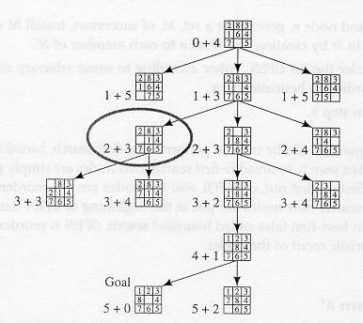
Heuristic Search using the
evaluation function

