Slide 1
Lecture 2 Basic Concepts in Community Medicine
By dr. umer farooq

Slide 2
Community Medicine
Community Medicine is the system of delivery of comprehensive health care by a health team in order to improve the health of the community
Comprehensive Health Care :
It is the delivery of personal and impersonal health services to the community for prevention of disease, cure of illness, prevention of disability, economic insecurity and dependency associated with illness

Slide 3
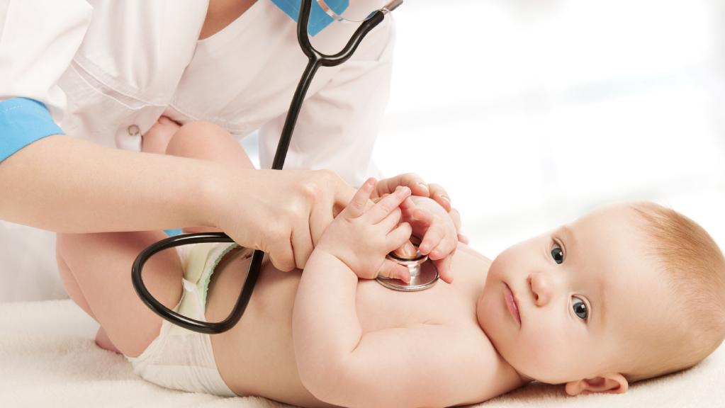
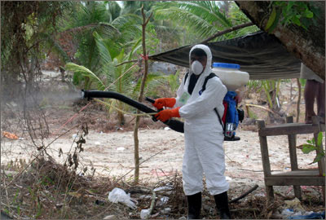
Personal Health Services :
These are health services which are directly directed for the care of the person e.g. maternal and child care, occupational health services and school health services. These are person oriented services
Impersonal Health Services :
These are community health services which indirectly influence the health of a person e.g. safe water supply, safe excreta disposal and vector control measures. These are community oriented services
Principles of comprehensive health care :
A’s of comprehensive health care
Availability
Acceptability
Accessibility
Affordability

Slide 4
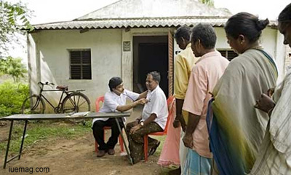
C.O.M.E
Community oriented Medical Education is a teaching methodology to produce community oriented doctors who are not only able to but also willing to serve the communities at primary, secondary and tertiary health care levels. In short, it is relevant medical education to the needs of the community
C.B.E
Community Based Education is defined as a system of education, which is carried out outside the teaching hospital in the community where first and second level health care facilities are available for this purpose, e.g. BHU, RHC and MCH Centers
C.B.L
It is Community Based Learning and is defined as learning process through tasks/ assignments, of students outside the teaching hospitals in places like schools, homes, slums, work places etc.

Slide 5
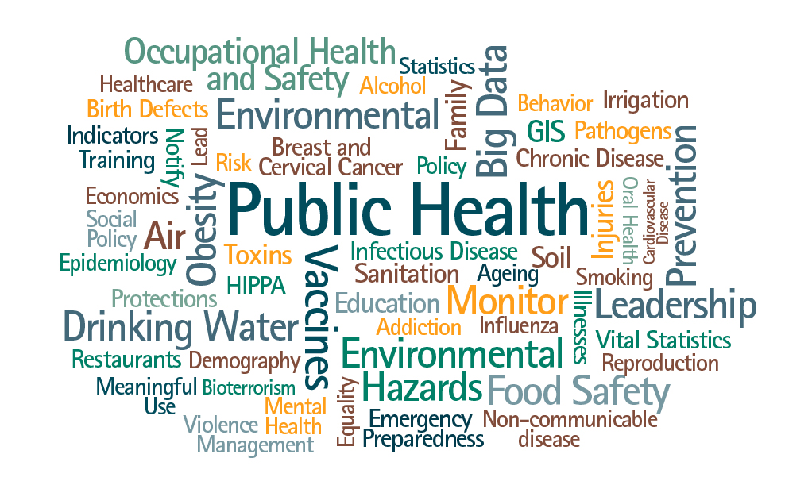
Health
It is the state of complete physical, mental and social well-being and not merely the absence of disease
Public Health :
It is the science and art of preventing disease, prolonging life, promoting physical and mental health and efficiency through organized community efforts for
The sanitation of environment
The control of communicable diseases
The education of individuals in personal hygiene
The organization of medical and nursing services for the early diagnosis and preventive treatment of disease
The development of social machinery to ensure everyone a standard of living adequate for the maintenance of health

Slide 6
Social Sciences
These are branches of science that deal with the human behavior. Understanding the human behavior in a community is important for health professionals
Some certain social sciences are
Sociology
Anthropology
Genetics
Psychology
Human ecology
History
Demography
Political science
Economics
Criminology

Slide 7
Disease
It is a condition in which body health is impaired. In other words, disease is departure from state of physiological or psychological wellbeing
Epidemic : It is unusual occurrence (in a community or a region) of a disease, specific health related behavior or other health related events, clearly in excess of expected frequency
Endemic : It is a constant presence of a disease or infectious agent within a given geographical area or population without importing from outside
Sporadic : It is the occurrences of cases irregularly, haphazardly from time to time and generally infrequently
Pandemic : It is an epidemic affecting the population over a large geographic area. Example is pandemic of Severe Acute Respiratory Syndrome (SARS) in 2004

Slide 8
Infection
Infection is entry and development or multiplication of an infectious agent in the body of man or animals. In result of infection, body defend itself by immune response
Reservoir : Any person, animal, arthropod, plant or non living substance or combination of these, in which an infectious agent lives and multiplies, on which it depends primarily for survival, and where it reproduces itself in such manner that it can be transmitted to a susceptible host is called reservoir
Types of reservoir :
1) Human Reservoir :
Cases, examples are measles, mumps, polio, hepatitis A & B
Carriers, examples are typhoid, cholera and dysentery

Slide 9
2) Animal reservoir :
The source of infection may sometimes be animals and birds e.g. dogs in rabies and ducks in influenza
3) Reservoir in non-living things :
Soil and inanimate matter can also act as reservoir of infection e.g. soil may harbor agents that cause tetanus, anthrax etc

Slide 10
Carrier of a disease :
It is an infected person or animal that harbors infective agent in the absence of discernible clinical disease and is capable of transmitting the agent to other persons
Types of carriers :
1) Incubatory carrier :
Incubatory or precocious carriers are those who excrete the pathogens during the incubation period, before the onset of symptoms or before the characteristic features of the disease are manifested. Examples are measles, mumps, polio, pertussis, influenza, diphtheria and hepatitis B
2) Convalescent carrier :
Person who continues to harbor the infective agent after recovering from the illness is called convalescent carrier. They may excrete the carrier for only a short period or they may become chronic carrier. Examples are typhoid fever, dysentery, cholera, diphtheria and whooping cough

Slide 11
3) Healthy carrier :
A person who remains well throughout the infection but is capable of transmitting the disease agent to the others. Healthy carriers emerge from sub clinical cases; examples are poliomyelitis, cholera, meningococcal meningitis and diphtheria
4) Chronic carrier :
A chronic carrier is the one who is a source of infection over a very long period and can repeatedly reintroduce the disease into an area which is otherwise free of infection. Examples are typhoid fever, hepatitis B, chronic dysentery and diphtheria

Slide 12
Modes of transmission of infectious diseases
1. Direct Transmission:
A) Direct Contact:
Skin to Skin e.g. STI and AIDS
Mucosa to Mucosa e.g. common cold, flue, influenza
Mucosa to skin e.g. STI, AIDS, leprosy, skin and eye infections
B) Droplet Infection :
Direct spray of droplets of saliva and nasopharyngeal secretions during coughing, sneezing, speaking and spitting e.g. respiratory infections, eruptive fevers, common cold, diphtheria, whooping cough, tuberculosis, meningococcal meningitis

Slide 13
C) Contact with soil e.g. hookworm and tetanus
D) Inoculation into skin or mucosa e.g. rabies, hepatitis B, hep C, HIV
E) Transplacental or vertical transmission e.g. TORCH agents (toxoplasma gondi, rubella, cytomegalovirus & herpes) syphilis, hepatitis B and HIV
2) Indirect Transmission:
A) Vehicle-borne : Transmission of infectious agent through the agency of water, milk, food, fruits, vegetables, blood or other tissue organs e.g. diarrhea, typhoid, cholera, polio, hepatitis A & E and food poisoning
B) Vector-borne : Transmission of infectious agent through an arthropod or any living carrier
Mechanical e.g. Typhoid through house fly / cockroaches
Biological e.g. Malaria through mosquito and plague through rat flea etc

Slide 14
3) Air borne:
A) Droplet Nuclei : These are the particles which are of 1-10 microns dried residue of droplets. They keep floating in the air e.g. tuberculosis, influenza, measles, chicken pox etc
B) Dust : Some of the larger droplets expelled during talking coughing or sneezing settle down on the dust e.g. Streptococcal and Staphylococcal infections
4) Fomite – Borne:
Inanimate articles contaminated by infectious discharge from a patient and capable of transferring the disease agent are called fomite e.g diphtheria, typhoid, bacillary dysentery, eye and skin infections
5) Unclean hands and fingers:
E.g. typhoid, dysentery, hepatitis A, Streptococcal and Staphylococcal infections

Slide 15
Thank you

