Slide 1
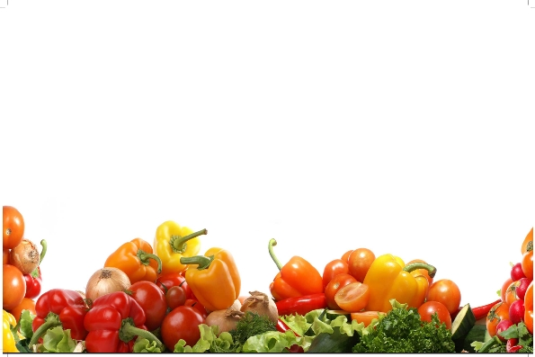
Maturity Indices for Fruits & Vegetables
Dr. SARFRAZ HUSSAIN

Slide 2
Types of indices and their components
Visual
a. Shape and Size:
Maturity of fruits can be assessed by their final shape and size at the time of harvest.
Fruit shape may be used in some instances to decide maturity.
Fullness of cheeks adjacent to pedicel may be used as a guide to maturity of mango and some stone fruits.

Slide 3
Visual Indices cont….
Some cultivars of banana become less angular in cross section as development and maturation progress.
Size is generally of limited value as a maturity index in fruit, though it is widely used for many vegetables, especially those marketed early in their development.

Slide 4
Visual indices con….
With these produce, size is often specified as a quality standard,
with large size generally indicating commercial over-maturity,
under-sized produce indicating an immature state.
The assumption, however, is not always a reliable guide for all-purpose.

Slide 5
Shape & Size

Slide 6
The visual appearance of fruit and vegetable is the most important quality factor, which decides its price in the market.
The consumer (wholesaler or retailer) observes the quality of fresh fruits and vegetables with their visual or external appearance.

Slide 7
The produce should attain proper shape and size.
Medium size produce is always preferred by the consumers, because they tend to view large fruits as more mature.
The appearance of the product is the most critical factor in the initial purchase,

Slide 8
Shape & size
while subsequent purchase may be more related to texture and flavor.
Therefore, subjective evaluation of size and shape of the produce should be conducted to meet the desired quality characteristics.

Slide 9
b. color
The loss of green color of many fruits is a valuable guide to maturity.
There is initially a gradual loss in intensity of color from deep green to lighter green,
With many commodities, a complete loss of green color with the development of yellow, red or purple pigments.

Slide 10
b. Color Cont…..
Ground color as measured by color charts, is useful index of maturity for apple, pear and stone fruits,
but is not entirely reliable as it is influenced by factors other than maturity.

Slide 11
Checking color with colory meter

Slide 12
color
For some fruits, as they mature on the tree, development of blush color, that is additional color superimposed on the ground color, can be a good indicator of maturity.
Examples are red or red-streaked apple cultivars and red blush on some cultivars of peach.

Slide 13
color
Objective measurement of color is possible using a variety of reflectance or light transmittance spectrophotometer.
Color perception depends on the type and intensity of light, chemical and physical characteristics of the commodity, and person’s ability to characterize color.

Slide 14
Color cont…..
Although human eye is used to evaluate colour but results can vary considerably due to human differences in colour perception.

Slide 15
Objective method) is used to provide a specific color value based on the amount of light reflected off the commodity surface or light transmitted through the commodity.
This instrument can measure small differences in color accurately and can be automated in the packing line.
This instrument is popularly known as Color Difference Meter.

Slide 16
This instrument use colorimetric method for colour measurement.

Slide 17
Physical indices
Firmness: As fruit mature and ripen they soften by dissolution of the middle lamella of the cell walls. The degree of firmness can be estimated subjectively by finger or thumb pressure, but more precise objective measurement is possible with pressure tester or penetro meter.

Slide 18
Firmness
In many fruits such as apple, pear, peach, plum, guava, kinnow firmness is used to determine harvest maturity.
Penetrometer measures the pressure necessary to force a plunger of specified size into the pulp of the fruit.
Such pressure is measured in kilograms force.

Slide 19
Penetro meter

Slide 20
b. Specific gravity
As fruit mature, their specific gravity increases. This parameter is rarely used in practice to determine when to harvest a crop but it could be where it is possible to develop a suitable sampling technique. It is used, however, to grade crops into different maturities. To do this the fruit or vegetable is placed in a tank of water; those that float will be less mature that those that sink.

Slide 21
Specific gravity
To give greater flexibility to the test and make it more precise, a salt or sugar solution can be used in place of water. This changes the density of the liquid, resulting in fruits or vegetables that would have sunk in water floating in the salt or sugar solution.

Slide 22
Chemical Measurement
Measurement of chemical characteristics of produce is an obvious approach of maturity determination.
The conversion of starch to sugars during maturation is a simple test for the maturity of apple cultivars.
It is based on the reaction between starch and iodine to produce a blue or purple color.
The intensity of the color indicates the amount of starch remaining in the fruit.

Slide 23
Chemical measurement
The total soluble solids of the fruit can be measured with refractro meter,
which indicate the harvest maturity of fruits. Acidity is readily determined on a sample of extracted juice by titration with alkaly.
The sugar acid or TSS acid ratio is often better related to palatability of fruit than either sugar or acid level alone.

Slide 24
Soluble Solid Contents (SSC)
Total soluble solids (TSS), can be determined in a small sample of fruit juice using hand refractometer.
The spectrometer measures the refractive index, which indicates how much a light beam will be slowed down when it passes through the fruit juice.

Slide 25
Soluble Solid Contents (SSC)
The refracto meter has different scales (0-32ºB), (28-62ºB) and (56-92ºB) which can be read directly.
For large size fruits should be cut from stem to blossom end and to the centre of the fruit to account for variability in SSC from top to bottom and inside to outside of the fruit.

Slide 26
Soluble Solid Contents (SSC)
The fruit tissues are macerated thoroughly in pastel motor and then from the pulp the juice is extracted by passing through muslin cloth.
A drop of juice is then put on the prism of the refractometer and TSS content can be read directly on the scale.
However, in case of small fruits like grapes, the juice content can be extracted by simply pressing the whole fruit.
The temperature of the juice is a critical factor for accuracy, because all materials expand when heated and becomes less dense.

Slide 27
Soluble Solid Contents (SSC)
Good quality refractometers have a inbuilt temperature compensation capability.
Always clean the refractometer before each reading and to standardize it with distilled water.

Slide 28
Titratable acidity
Titratable acidity (TA) can be determined by titrating a know volume of juice with 0.1N NaOH to end point of pink red color by using phenolphethline as an indicator.

Slide 29
Calculated indices:
Calendar Date: For perennial fruit crops grown in seasonal climate which are more or less uniform from year to year, calendar date for harvest is a reliable guide to commercial maturity.
Time of flowering is largely dependent as temperature and the variation in number of days from flowering to harvest can be calculated for some commodities by use of degree-day concept. Such harvesting criteria can be developed by the growers based on their experiences.

Slide 30
Heat Units
Heat Units: An objective measure of the time required for the development of the fruit to maturity after flowering can be made by measuring the degree days or heat units in a particular environment.
It has been found that a characteristics number of heat unit or degree-days is required to mature a crop under usually warm conditions, maturity will be advanced and under cooler conditions, maturity is delayed.

Slide 31
Heat Units
The number of degree days to maturity is determined over a period of several years by obtaining the algebraic sum from the differences, plus or minus, between the daily mean temperatures and a fixed base temperature (commonly the minimum temperature at which growth occurs).

Slide 32
Heat Units
The average or characteristic number of degree-days is then used to forecast the probable date of maturity for the current year and as maturity approaches, it can be checked by other means.

Slide 33
Maturity Indices for selected fruits & Vegetables
Okra (Pod 2-4” long, not fibrous, tips of pods pliable).
Brinjal (Immature, glossy skin, 40days from flowering).
Broccoli (Adequate diameter, compact, all florets should be closed).
Cabbage (Firm head),

Slide 34
Carrot (Immature, roots reached adequate size).
Cauliflower (Mature and at least 6” in diameter, compact).
Cucumber (Immature and glossy skin),
Garlic (Well filled bulbs, tops dry down).
Ginger (8-9 months after planting).

Slide 35
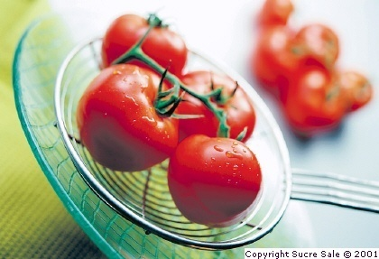
Thanks

