Slide 1
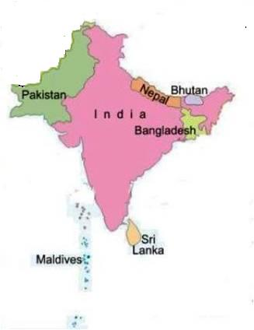
Oriental region
Pakistan (excluding Baluchistan)
India
Sri lanka
Burma
Malaysia
Indonesia
Nepal
Bhutan
Borneo
Java

Slide 2
Boundaries
The North of this region Himalayas are present.
The West of it Arabian sea is present.
The South east corner physical boundary is absent where the islands of Malayan archipelago string out untill they reach Australia.
Notes:
The Himalayan slopes with all the Indo-Chinese countries form the chief and most typical part of the regions
Malayan archipelago:
The Malay Archipelago refers to the archipelago between mainland Southeastern Asia and Australia.
Archipelago:Chain or cluster of island

Slide 3
CLIMATE:
Mainly Tropical
Average temperature :
30°C
Relative humidity:
87%
Rain fall:
Total average rainfall is 2.423 mm.
(Through out the year)
Heavier at mountain ranges :
(5.000 mm per year)
In north east part :
Less (3.000 mm per year)
Notes:
The average is 30°C in winter and 30°C in summer

Slide 4
4 SEASONS OF THE YEAR
Notes:
Summer ,winter ,spring ,autumn

Slide 5
Physical Features
Great variety of physical features
In India:
North part:
Grassy Plains with scattered trees and bushes
South:
Rich in vegetation (luxuriant Forests)
North west:
Deserts

Slide 6
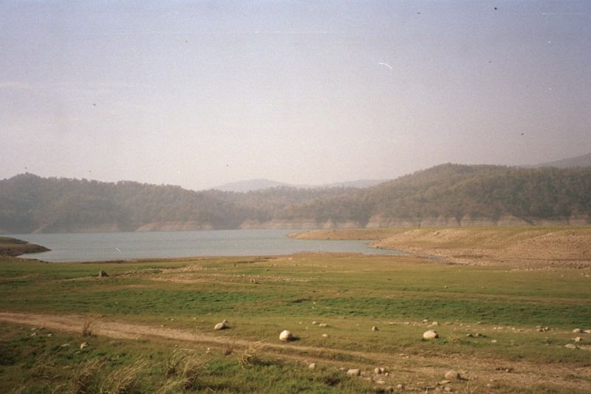
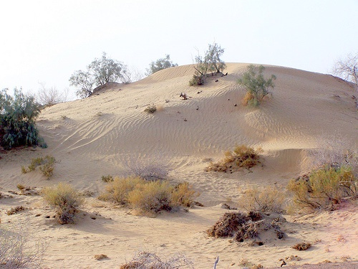
North parts
North west
South
Notes:
TROPICAL FORESTS…..Most of the world's rainforests are in South America (57 percent), South-East Asia (25 percent) and Africa (18 percent). There are also smaller areas of rainforest in Central America, Madagascar, India and Australia. Rainforests cover approximately 6 percent of the Earth's land. This does not include areas of water such as the oceans, rivers and lakes of the world.

Slide 7
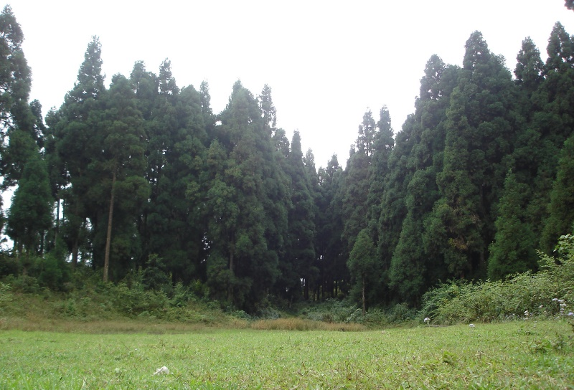
Srilanka, Malaysia, Indonesia, Indochinese are almost entirely covered with thick tropical forests and posssess a varied and extremely rich fauna
Notes:
Tropical rainforests are located around the equator, which is an imaginary line that cuts the world into north and south. Tropical rainforests lie between the Tropic of Cancer in the north and the Tropic of Capricorn in the south. The largest areas of rainforest are found in Brazil, which is in South America. The Democratic Republic of Congo, which is in Africa, has the second-largest area of rainforest. The third-largest area of rainforest is found in Indonesia,

Slide 9
Wallace’s Line
Wallace Line is an imaginary line in Indonesia runs through Borneo and Sulawesi
Imaginary line separating Oriental & Australian faunal realms
Ecological significance :
separates two zoogeological regions that are respectively associated with Asia and Australia.
Notes:
BY Alfred Wallace ,Things are fuzzy on periphery (transitional zone)

Slide 11
BIO DIVERSITY AROUND WALLACE’S LINE
To the west of the line, fauna is more Asian.
To its east, it resembles the Australian fauna
Region is home to over 10,000 plant species.
15% of which are endemic.
1142 terrestrial vertebrate species.
half (529) are endemic ,as
Macaque monkey
Anoa
Babirusa
Notes:
7 sp of monkey ;2anoa

Slide 12
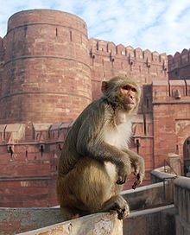
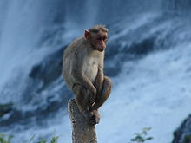
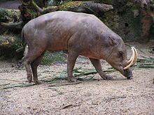
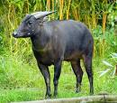
Rhesus macaque
Boonnet Macaque
Low land anoa
Mountain Anoa
Babirusa
Notes:
RHESUS MOCAQUE:The Rhesus macaque (Macaca mulatta), also called the Rhesus monkey, is one of the best known species of Old World monkeys. It is listed as Least Concern in the IUCN Red List of Threatened Species in view of its wide distribution, presumed large population, and its tolerance of a broad range of habitats. Native to South, Central and Southeast Asia, Rhesus macaques are diurnal animals, and both arboreal and terrestrial. They are mostly herbivorous feeding on mainly fruit, but also eating seeds, roots, buds, bark, and cereals.
Bonnet macaque:The bonnet macaque (Macaca radiata) is a macaque endemic to southern India. This Old World monkey is a diurnal animal.^{[citation needed]} It is 35-60 cm long plus a tail of 35-68 cm. Males weigh 5.5 to 9 kg., females 3.5 to 4.5 kg. It can live more than 30 years.^{[citation needed]}
The bonnet macaque feeds on fruits, nuts, seeds, flowers, invertebrates and cereals.
ANOA:Anoa, or Dwarf Buffalo, are a subgenus of Bubalus comprising two species native to Indonesia: the Mountain Anoa (Bubalus quarlesi) and the Lowland Anoa (Bubalus depressicornis). Both live in undisturbed rainforest, Both are found on the island of Sulawesi in Indonesia; weighing 150–300 kg (330–660 lb). Both are found on the island of Sulawesi in Indonesia; Reasons for the decline of the anoa include hunting for hide, horns and meat by the local peoples and loss of habitat due to the advancement of settlement. Currently, hunting is the more serious factor in most
BABIRUSA:The babirusas are a genus, Babyrousa, in the pig family (Suidae) found in Wallacea, or specifically the Indonesian islands of Sulawesi, Togian, Sula and Buru.[

Slide 13
SUB REGIONS
It consists of 4 sub regions:
Indian sub-region
Ceylon sub-region
Indo-China sub-region
Indo-Malayan sub-region

Slide 15
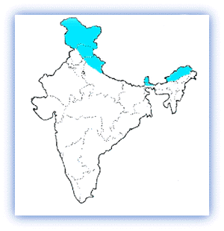
Indian Sub-Region:
Himalaya
It includes North India and Central part.
It starts from the root of Himalaya and extend up to Malabar Coast
Notes:
The Malabar Coast,, refers to India's southwestern coast, lying on the narrow coastal plain of Karnataka and Kerala states between the Western Ghats range and the Arabian Sea
The Indian Himalayas cover a vast area along the northern frontiers of the country and span five Indian States -- Jammu and Kashmir , Himachal Pradesh, Uttar Pradesh, Sikkim and Arunachal Pradesh -- from west to east

Slide 16
Malabar Coast
Notes:
More than 340 miles long, Kerala's Malabar Coast:The Indian Himalayas cover a vast area along the northern frontiers of the country and span five Indian States -- Jammu and Kashmir , Himachal Pradesh, Uttar Pradesh, Sikkim and Arunachal Pradesh

Slide 17
High rainfall
Less snowfall confined to high altitude
This region shows plains and deserts.
Temperate and tropical conditions.
Extensive and fertile region
Though abounding in life of every kind
Notes:
With increase in altitude in the western part of the Himalayan sub region, the tropical forests merge into the temperate type.

Slide 18
FAUNA
No peculiar genus of either Mammalia or birds
Some African types are more abundant
Antelopes
Peacock
Indian Bison
Black Elephant
snakes
Notes:
The Asian elephant, Elephas maximus, is smaller than the African. It has smaller ears, and typically, only the males have large external tusks. further subspecies was identified on Borneo. Named the Borneo pygmy elephant, it is smaller and tamer than any other Asian elephants. It also has relatively larger ears, longer tail and straighter tusks.
BISON:They are the heaviest and most powerful of all wild cattle, and are among the largest living land animals; only elephants, rhinos and hippos consistently grow larger, and the weight of gaur may equal or even surpass that of a giraffe

Slide 19
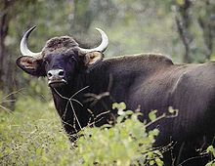
Elephant
Pea cock
Indian Bison
Notes:
Indian Peacock Pavo cristatus, a resident breeder in the South Asia. The peacock is designated as the national bird of India and the provincial bird of the Punjab.
Green Peafowl, Pavo muticus. Breeds from Burma east to Java. The IUCN lists the Green Peafowl as vulnerable to extinction due to hunting and a reduction in extent and quality of habitat. blue-green or green colored plumage. The peacock tail ("train") is not the tail quill feathers but the highly elongated upper tail coverts. The "eyes" are best seen when the peacock fans its tail. Both species have a crest atop the head. The peafowl are forest birds that nest on the ground but roost in trees. They are terrestrial feeders.

Slide 20
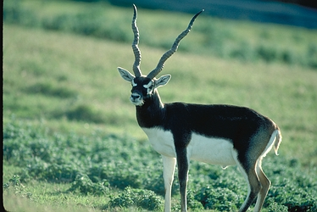
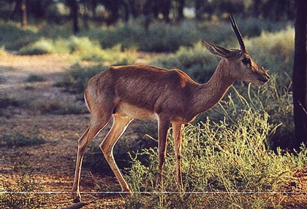
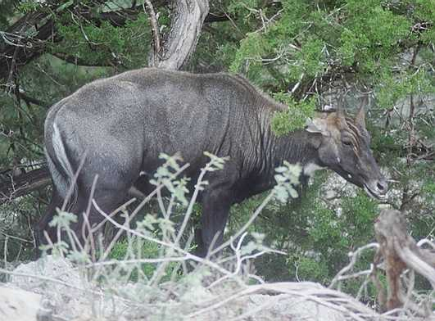
Antelopes
Indian Gazelle
Black Buck
Nil gai
Notes:
Antelope is a term referring to many even-toed ungulate species. many other herbivores, antelopes rely on keen senses to avoid predators

Slide 21
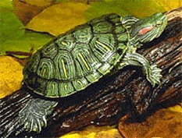
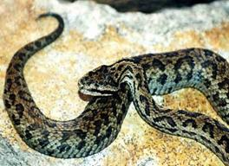
Himalayan pit viper
Turtle
PYTHON
Python
Notes:
Python is a common name for a member of Python (genus), or more generally for any Python is a common name for a member of Python (genus), or more generally for any member of the family Pythonidae, the family to which the python genus belongs.
Gloydius himalayanus is a venomous pitviper species found along the southern slopes of the Himalayas in Pakistan, India and Nepal.

Slide 22
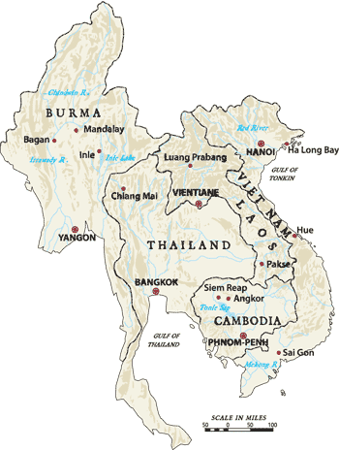
2.Indo china
The Indochina includes most of mainland south east Asia
Including Myanmar, Thailand,Loas, Vietnam and Cambodia, as well as the subtropical forests of southern china
Notes:
Laos is mountainous, sparsely populated, and landlocked between Vietnam, Cambodia, and Thailand
It is a varied land with highlands and populous lowlands

Slide 23
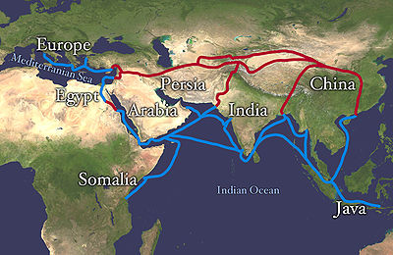
FEATURES
Only direct link between India and china
Average temperature:
Ranges between 20-30 degree Celsius
Notes:
The Silk Road extending from southern and eastern Europe through Egypt, Somalia, the Arabian Peninsula, Iran, Central Asia, Ancient India, Java-Indonesia, and Vietnam until it reaches China. The land routes are red, and the water routes are blue.

Slide 24
Rain Fall
About 60 to 80 inches of average annual rainfall.
During the summer the rains are rare, and usually very heavy .
The heaviest showers fall between May and August, and a rainfall of four inches within twenty-four hours has been recorded in the these month.
Notes:
Precipitation tends to occur during the southwest monsoon

Slide 25
Fauna
The greatest variety of Mammalia and birds, and almost all the more important groups are represented.
Three genera of Mammalia and 44 genera of birds are peculiar to this sub-region.
It includes
Gibbon
Rhinoceros
Turtles
Tortoises etc
Notes:
The Indian Rhinoceros (Rhinoceros unicornis) is also called Greater One-horned Rhinoceros and Asian One-horned Rhinoceros and belongs to the Rhinocerotidae family. Listed as a vulnerable species. Weighing between 2260 kg and 3000 kg, it is the fourth largest land animal and has a single horn, which measures 20 to 57 cm (7.9 to 22 in) in length. Found in northern Uttar Pradesh, northern Bihar, northern Bengal, and in the Brahmaputra Valley of Assam.^{[7]}

Slide 26
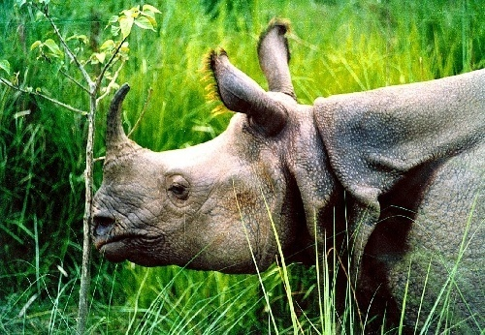
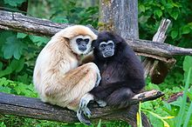
GIBBONS
INDIAN RHINOCEROS
Notes:
gibbons inhabit regions of Assam, Myanmar, the Indochinese peninsula, and the Greater Sunda Islands; while the orangutan is restricted to Sumatra and Borneo, where it is in danger of extinction
Gibbons are apes in the family Hylobatidae . Gibbons occur in tropical and subtropical rainforests from northeast India to Indonesia and north to southern China, including the islands of Sumatra, Borneo and Java. They can also make leaps of up to 8 m (26 ft), and walk bipedally with their arms raised for balance. They are the fastest and most agile of all tree-dwelling, non-flying mammals

Slide 27
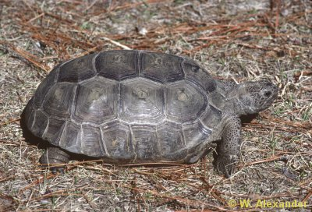
Turtles
Tortoise
Notes:
Turtle …shell is stream lined ,soft ,mostly live in water ,feet webbed,life span 20 -40 yrs
Tortoise…feet short with bent legs ,shell hard and dome shape ,life span 80-150 yrs ,dwell well on land

Slide 28
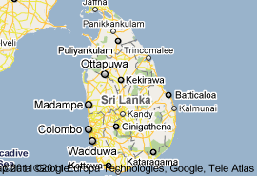
3. Ceylon sub-region
It includes Ceylon, Small Indian Peninsula.
(Southern India )
Notes:
Ceylon, is an island nation in the Indian Ocean, located in Southern Asia, southeast of India, in a strategic location near major Indian Ocean sea lanes.

Slide 29
Notes:
The mountains and the southwestern part of the country, known as the "wet zone,"

Slide 30
Climate
The Climate of Ceylon is mainly tropical
Ceylon is situated near the equator, the climate is generally hot and humid.
The hill and mountain areas however are cool and the humidity is relatively lower in lower lands
The average annual temperature is about 32°C in the lowlands and about 21°C in the higher mountainous regions
Notes:
Monsoon rains occur in the northern and eastern regions in December and January. Monsoon rains occur in the northern and eastern regions in December and January.

Slide 31
The mountains and the southwestern part of the country, known as the wet zone
Most of the southeast, east, and northern parts of the country comprise the dry zone
RAIN FALL
Dry zone :
between 1200 and 1900 mm of rain annually.
wet zone :
an annual average of 2500 millimeters .

Slide 32
Birds
About 450 species of birds, nearly 250 are resident and 23 are endemic of which the majority are found in the lowland zone and the rainforests of the hill country and others are migratory

Slide 33
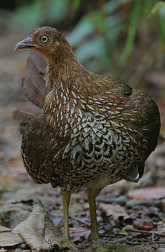
ENDEMIC
Whistling-thrush
jungle fowl
Notes:
Whistling-thrush, Myophonus blighi, is a whistling thrush in the thrush family Turdidae. It is a resident endemic bird in Sri Lanka. It is found in the highlands of Sri Lanka in jungle or other dense forest near water. It is omnivorous, eating a wide range of insects, frogs, earthworms and berries. It lays one or two eggs in a neat cup-shaped nest in a bush
The Sri Lankan Junglefowl (Gallus lafayetii), also known during the colonial era as the Ceylon Junglefowl, is a member of the pheasant family which is endemic to Sri Lanka, where it is the national bird. It is closely related to the Red Junglefowl (G. gallus), the wild junglefowl from which the chicken was domesticated. As with most other pheasants, Sri Lanka Junglefowl is a terrestrial species. It spends most of its time foraging for food by scratching the ground for various seeds, fallen fruit and insects. It is a ground nesting bird, and lays 2-4 eggs in a nest.

Slide 34
Mammal
113 mammal species
One is critically endangered
10 are endangered
10 are vulnerable
3 are near-threatened
OTHERS
Red Slender Loris
Elephants
Nilgai
Notes:
Loris is the common name for the strepsirrhine primates of the subfamily Lorinae in familyLorisidae. Lorises are nocturnal. They are found in tropical and woodland forests of India, Sri Lanka, andsoutheast Asia.
Endangered…
The endangered animals of Sri Lanka are the Asian elephant, blue whale, fin whale, jungle shrew, Kelaart's long-clawed shrew, Pearson's long-clawed shrew, purple-faced leaf monkey, Sri Lankan long-tailed shrew and Sri Lanka shrew, red slender loris.
VULNERABLE
Sri Lanka's animals that are vunerable include the dhole, dugong, Eurasian otter, fishing cat, humpback whale, Nolthenius' long-tailed climbing mouse, rusty-spotted cat, sloth bear, slow loris, sperm whale, Sri Lankan giant squirrel, Sri Lankan highland shrew and toque macaque.
C. END …NILLU RAT

Slide 35
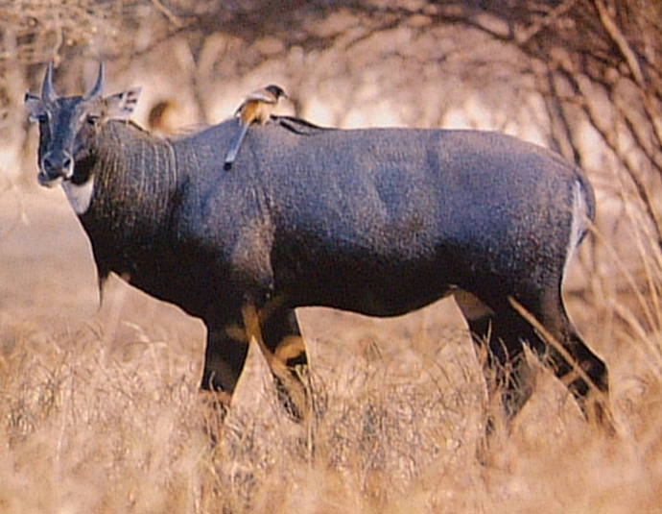
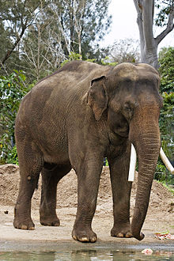
Nil gai
Elephant
Loris
Notes:
Lorises are nocturnal. They are found in tropical and woodland forests of India, Sri Lanka, and southeast Asia, Some lorises are almost entirely insectivorous, while others also include fruits, gums, leaves, and slugs in their diet.
^{ELEPHANT;} Elephus maximus. The Asian elephant differs from its cousin, the African elephant, in several ways: the Asian is smaller, with shorter ears, a single (not double) "finger" at the end of the trunk, a more rounded back, and 4 nails, instead of 3, on its hind feet.

Slide 36
4. Indo-Malayan Sub Region
Includes Malayan peninsula and surrounding Islands
as far as Java, Borneo, and the Philippines
Notes:
Diverse habitats, from torrid coastal swamps to glaciers, support the dazzling variety of life forms. While Malaysia’s biodiversity does not match up to that of Indonesia

Slide 37
FAUNA
Common to the Malayan and the Indo-Chinese sub-regions
14 genera of Mammalia
More than 40 genera of birds
(which are wholly peculiar to it)

Slide 38
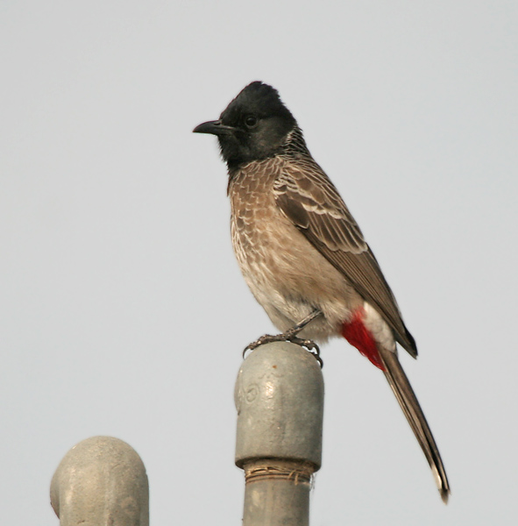
Red vented Bul bul
Rock pigeon
Notes:
Pigeon…The Rock Pigeon (Columba livia), or Rock Dove, is a member of the bird family Columbidae (doves and pigeons).^{[3]} In common usage, this bird is often simply referred to as the "pigeon". The species includes the domestic pigeon
Harm less, gregarious, monogamous, donot sing but chirp
Bul bul…asia ,india china srilanka,feed on fruits ,nectar,insects etc,

Slide 39
Gibbon
Loris
INDIAN RHINOCEROS
Elephant
Notes:
Gibbons are apes in the family Hylobatidae

Slide 40
FLORA
Ginkgo
Bonsai
Bamboo
Notes:
Ginko:The oldest tree in the world which first appeared during the Jurassic age some million years ago.

Slide 41
FAUNA

Slide 42
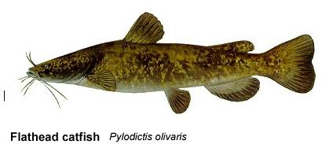
FISHES
Fish fauna of Oriental region will resemble that of Ethiopian region.
Oriental fish fauna is dominated by
Carps
Cat fishes.
Notes:
Absence of primitive groups,dominance of cyprinids (as carps and Cat fish)

Slide 43
Amphibians in oriental region
Urodeles (tailed Amphibians) are absent
Common frog and toad are common
Rana species
Hyla species
Notes:
Urodeles (tailed amphibians) are absent

Slide 44
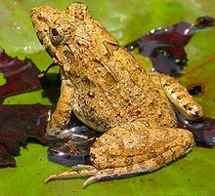
Hyla annectans
( Toad)
Hoplobatrachus tigerinus
(Indian bull frog)
Notes:
FROG …found in India, Pakistan and Nepal.Order ,,anura,family Ranidae
TOAD…Head broader than long; snout short, rounded; canthus rostralis distinct; interorbital space as broad as the upper eyelid; tympanum distinct, about half the diameter oi the eye. lingers webbed at the base; toes two-thirds webbed; disks well developed. Hyla annectans is a species of toad found in India.

Slide 45
Reptiles in oriental region
Reptiles are very abundant.
This fauna is dominated by
Lizards
Snakes (Poisonous snakes)
Turtles
Crocodiles
Notes:
^{i}

Slide 46
Endemic Reptiles
Families include
Elachistodontidae (Egg eating snakes)
Uropeltidae (Shield tail snake)
Lanthanotidae (Lizards)
Gavialidae (Gavials)
Platysternidae (Big headed turtle)

Slide 47
Uropeltidae (Shield tail snake)
Notes:
Shield tail or pipe snakes found in southern India and Sri Lanka. The name is derived from the Greek words ura ("tail") and pelte ("shield"), indicating the presence of the large keratinous shield at the tip of the tail. Currently, 8 genera are recognized comprising 47 species. These snakes are nonvenomous.

Slide 48
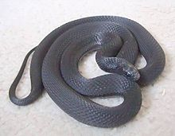
Elachistodontidae (Egg eating snakes)
Notes:
(Elachistodon westermanni) is a rare species of egg-eating snake found in Bangladesh, India, and Nepal. It is nocturnal. The snake has special adaptations such as a vertebral hypapophysis, a projection of the backbone, that juts into the oesophagus and helps in cracking eggs.

Slide 49
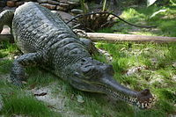
Gavialidae (Gavials)
Notes:
Gavialidae consists of only one surviving species, the gharial (Gavialis gangeticus), which is native to India.It has much thinner snout. The thin snout is used to catch fish, as gavialids lack the jaw strength to capture the large mammalian prey.

Slide 50
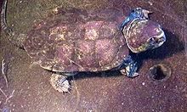
Platysternidae (Big headed turtle)
Notes:
It is found in China, Laos, Myanmar, Thailand, and Vietnam. In addition to a very large head, the big headed turtle is known to readily climb trees near rivers and fast streams. The big headed turtle cannot pull its head in its shell. Platysternon will not hesitate to use its powerful jaws to defend itself. It is a fish and snail eater.

Slide 51
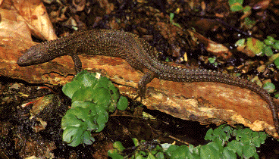
Lanthanotidae (Lizards)
Notes:
includes a single species, Lanthanotus borneensis, that is restricted to Borneo. Lanthanotus gets its common name from its lack of external ear opening, and although ear structures are fully developed underneath the skin, it does not respond much to auditory stimulus. Its eyes are reduced, as are its nostrils, and it probably relies on its tongue for chemosensory reception . The natural food is unknown, mostly eats eggs, worms, and fish.

Slide 52
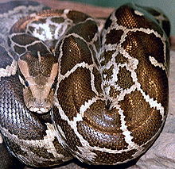
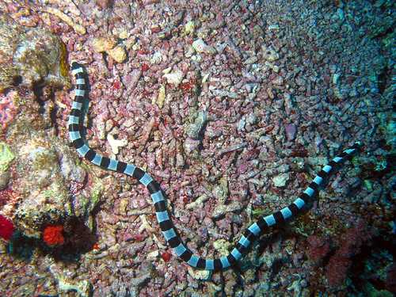
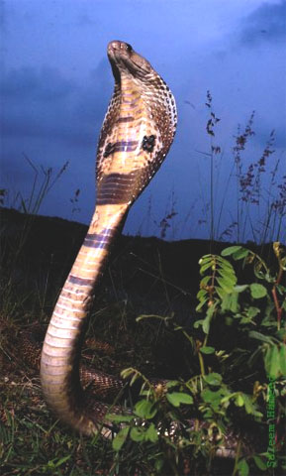
Python
Krait
Russell's viper
Indian cobra
Notes:
Pythons are Nonpoisonous snakes. Pythons are large and muscular, and kill their prey by squeezing, or constricting, until it suffocates. Although most feed on small mammals, some large species can kill and swallow small pigs and goats. Rarely they killed humans.
KRAITS:The common krait (Bungarus caeruleus) is found in the jungles of the Indian sub-continent. This snake is highly venomous.. Krait venom is extremely neurotoxic and induces muscle paralysis. Kraits are nocturnal and seldom encounter humans during daylight hours, so incidents are rare. These snakes prey on other snakes, lizards, frogs, rats, and mice
Naja naja or the Indian cobra is a species of venomous snake found in the Indian subcontinent.. The Indian cobra's venom contains a powerful post-synaptic neurotoxin. The venom acts on the synaptic gaps of the nerves, thereby paralyzing muscles, and in severe bites leading to respiratory failure or cardiac arrest
Daboia is a monotypic genus^{[8]} of venomous Old World viper. The single species, D. russelii, is found in Asia throughout the Indian subcontinent, much of Southeast Asia, southern China and Taiwan.It is a member of the big four venomous snakes in India. It is one of the species responsible for causing the most snakebite cases and deaths in the world due to various factors such as its frequent occurrence in places where humans are occupied. The color pattern consists of a deep yellow, tan or brown ground color, with three series of dark brown spots that run the length of its body. Each of these spots has a black ring around it, the outer border of which is intensified with a rim of white or yellow.

Slide 53
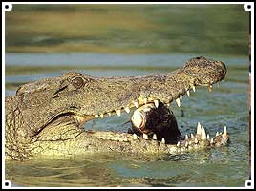
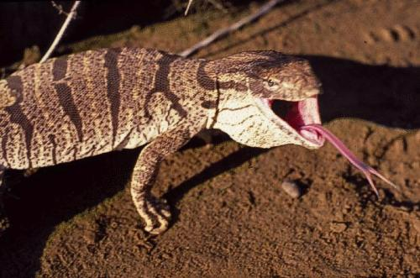
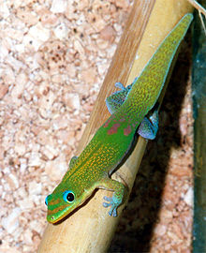
Crocodile
Monitor Lizard
Geckos
Notes:
In the Desert Monitor the Dorsum is gray to yellowish brown; body and tail with brownish crossbars; 2-3 streaks on neck; ventrum yellowish.. It is very secretive monitor and is more active during the early hours of the day, spending most of its time in its burrow. It feeds on rodents, lizards, snakes, birds, eggs, frogs, and toads. Since it is a varanid of warm areas, it is not known to hibernate..
GECKOS::widely distributed through out the world .. Have no eye lids but transparent membrane ,specialized toe pads that enable them to climb on vertical and smooth surfaces,

Slide 54
BIRDS
66 families of Birds
More than 340 genera of land-birds ,
165 are peculiar to it.
About 961 species in this region.

Slide 55
Endemic Family :
Eurylaemidae
(Long Tailed Broad bills
(Psarisomus dalhousiae)
Notes:
The broadbills are a family of small passerine birds, Eurylaimidae
The broadbills are a family of small passerine birds, Eurylaimidae. The Smithornis and Pseudocalyptomena species occur in sub-Saharan Africa; the rest extend from the eastern Himalayas to Sumatra and Borneo. The broadbills are for the most part insectivorous and carnivorous.. They are generally gregarious, with many species moving about in flocks of about 20 individuals
Long-tailed Broadbill (Psarisomus dalhousiae) is a resident in Himalayan foothills and north-east India.
Size: 28 cm

Slide 56
Wood Pecker
Pea- cock
Pigeons
King fisher
Crows
Bulbul
Babbler
Orioles
Weaver Bids etc

Slide 57
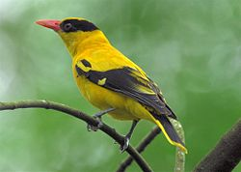
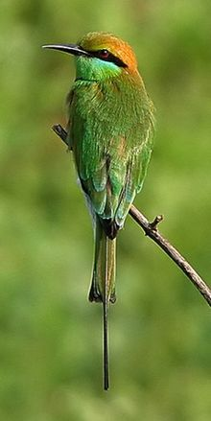
Green Bee Eater
Golden Oriole
Notes:
.
goldenOriole ; Himalayan range states,Western ghats of South India and Sri Lanka
Old World orioles in the genus Oriolus.[Orioles are arboreal . They are opportunistic omnivores, with the main components of their diet being fruit, berries, and arthropods.
Bee Eater:
Nyctyornis is restricted to Asia, ranging from India and southern China to the Indonesian islands of Sumatra and Borneos
…The Green Bee-eater, Merops orientalis, (sometimes Little Green Bee-eater) is a near passerine bird in the bee-eater family. India to Vietnam.^{[2]} They are mainly insect eaters and they are found in grassland,

Slide 58
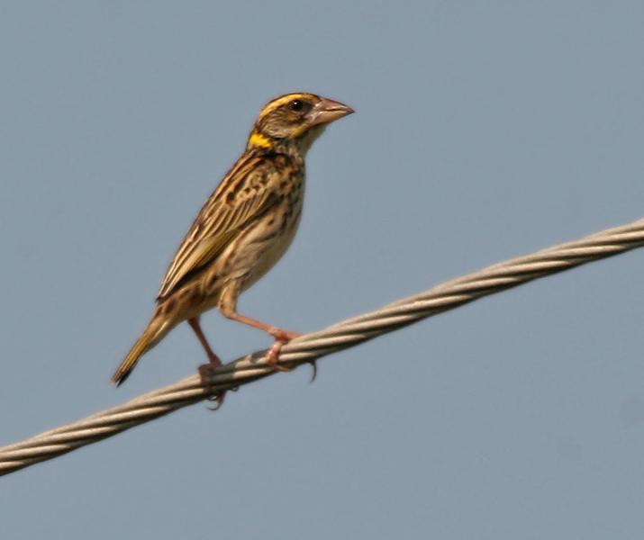
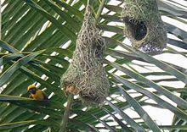
Weaver Birds
Baya Weaver
Streak Weaver
NESTS
Notes:
The Baya Weaver (Ploceus philippinus) is a weaverbird found across South and Southeast Asia. Flocks of these birds are found in grasslands, cultivated areas they are best known for their hanging retort shaped nests woven from leaves. These nest colonies are usually found on thorny trees or palm where predators cannot reach easily. Streaked Weaver (Ploceus manyar) is a species of weaver bird found in South Asia. These are not as common as the Baya Weaver but are similar looking but have streaked underparts.

Slide 59
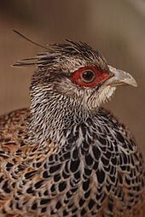
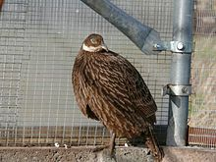
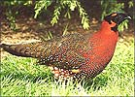
Pheasants
Cheer Pheasant
Himalayan monal
Koklas
Kalij
Notes:
The Himalayan Monal, Lophophorus impejanus also known as the Impeyan Monal or Impeyan Pheasant or Danphe is a bird of genus Lophophorus of the pheasant family, Phasianidae….. Its natural range spreads from eastern Afghanistan through the Himalayas including Kashmir region of Northern Pakistan, India (states of Himachal Pradesh, Uttarakhand, Sikkim and Arunachal Pradesh), Nepal, southern Tibet and Bhutan. There is also a report of its occurrence in Burma.. Adult males possess a long crest, are feathered with multicoloured plumage throughout their body, while the females, like in other pheasants, are dull in colour with the upper parts covered with dark brownish-black feathers. The Kalij Pheasant, Lophura leucomelanos, is a pheasant found in forests and thickets, especially in the Himalayan foothills, from the Indus River to western Thailand. Males are glossy bluish-black plumage, while females are overall brownish. Both genders have a bare red face and greyish legs.
KOKLAS>>This is a medium-sized pheasant associated with montane woodlands, including both hardwood and coniferous forests. The chestnut breast, black head, and white patches on the sides of the neck are unique, and the female also has a distinctive whitish patch along the side of the neck. Both sexes have somewhat elongated blackish to brownish tails, with paler tips, and tapering occipital crests that in the male are sometimes raised into ear-like display structures. The male's call in spring and summer is a loud pok-pok-pok . . . pokias, uttered mainly during morning and evening hours
CHEER:The Cheer Pheasant is distributed in the highlands and scrublands of the Himalayas region of the India, Nepal, Kashmir and Pakistan. These birds lack the color and brilliance of most pheasants, with buffy gray plumage and long gray crests. Its long tail has 18 feathers and the central tail feathers are much longer and the colour is mainly gray and brown. The female is slightly smaller in overall size.

Slide 60
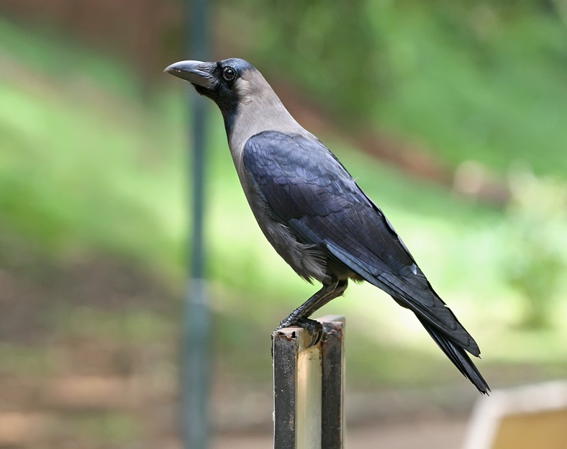
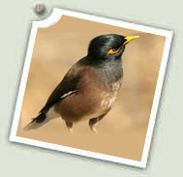
Common Babbler
Golden Backed Wood pecker
Crow
Myna
Notes:
WOOD PECKER…pak ,india ,srilanka,feed on insects and nectar,
Babbler..known as common babbler or old world babbler

Slide 61
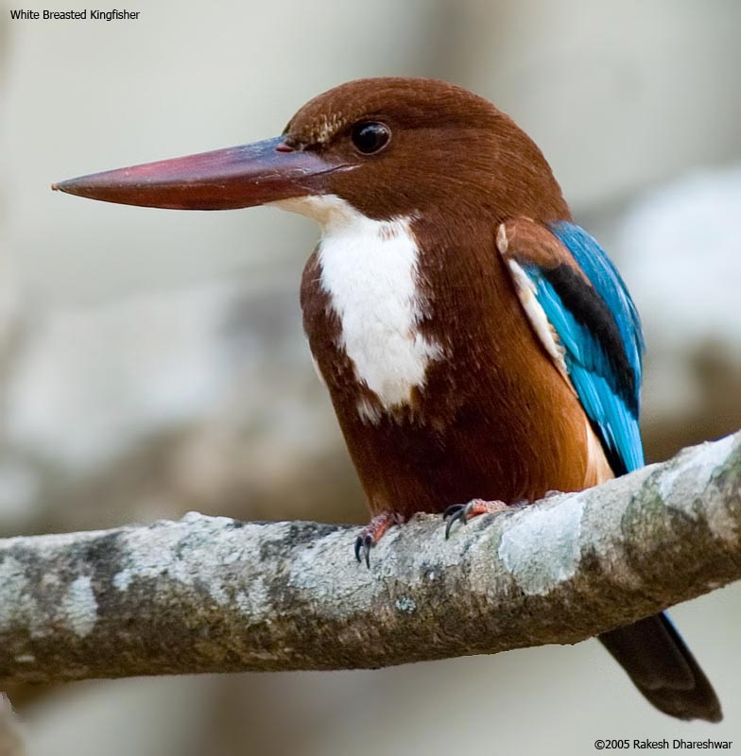
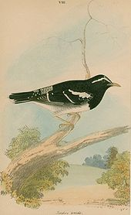
Red vented bul bul
Rock Pigeon
White Breasted King Fisher
Pied Thrush
Notes:
The Pied Thrush (Zoothera wardii) is a member of the thrush family found in India and Sri Lanka. The males are conspicuously patterned in black and white while the females are olive brown and speckled. They forage alone or in pairs, often seen on the ground but flying into the trees and perching still when disturbed. The Pied Thrush, like many Zoothera thrushes, can be quite secretive.^{[5]} Pied Thrushes are omnivorous, but eat more insects than fruit. They form loose flocks in winter.
King fisher …..it is a tree king fisher, adults have bright blue back,wings and tail while throat and breast is white,its noisy in breeding season,
KING FISHER:The White-throated Kingfisher (Halcyon smyrnensis) also known as the White-breasted Kingfisher or Smyrna Kingfisher, is a tree kingfisher,^{[2]} widely distributed in Eurasia from Bulgaria,^{[3]} Turkey, east through South Asia to the Philippines
In india it is also found in heryana and kerala,feed on rodents ,snakes fishes ,frogs etc

Slide 62
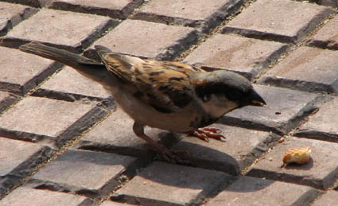
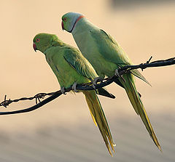
Rose ringed Parrot
House Sparrow
Notes:
ROSE RINGED PARROT (Psittacula karameri)….gregarious <popular as pet ,Sexually dimorphic,can Mimmic humans speech,feed on fruits seeds,nuts etc
HOUSE SPARROW:Passer domesticus:IN india and pak specially, : Small, seed-eating passerine bird with thick, conical bill and pink legs. Adult male: Gray crown, black throat, upper breast, and small mask; less black on throat in winter. Grayish side of neck and underparts. Rusty-brown nape and upperparts. Black streaks on back. White patch in wing. Gray rump. Black bill in summer; yellowish in winter. Female and immature: Gray-brown crown. Buffy line extends rearward from eye bordered below by gray-brown line. Grayish-white underparts. Black and tawny streaks on back. Black wing feathers with wide tawny edges. White patch on wing. Yellow bill. Immature males lack full throat patch of adults.

Slide 63
Peacock
Notes:
Native :peacock

Slide 64
Mammals
This region includes 30 mammalian families.
11 sub families
303 Genera
1000 Species
http://www.amazon.com/Mammals-Indomalayan-Region-Systematic-Review/dp/0198546939
Notes:
In pakistan 167 mammalian spp are present It includes 43 rodents, 44 bats, 15 artiodactela , 1 perissodactyla , 33 carnivorea, 12 insectivora, 1 pholidota, 2 primates and 13 cetaceans.

Slide 65
Endemic Families
Hylobatidae (Gibbons)
Tarsiidae (Tarsiers)
Tupaiidae (Tree Shrew)
Galeopithecidae (Flying Lemur)

Slide 66
Hylobatidae (Gibbons)
Notes:
Gibbons are apes ,occur in tropical and sub tropical rain forests,different from great apes(champanzies etc )

Slide 67
Tarsiidae (Tarsiers)
Notes:
Found in islands of south east asia,These are haplorrhine primates (dry nose), Eye ball 16 mm in diameter ,Nocturnal,

Slide 68
Tupaiidae (Tree Shrew)
Notes:
Found in tropical forests, not true shrew , not arboreal, omnivorous, also eat rafflesia fruits(parasitic flowering plant;indonesia)

Slide 69
Galeopithecidae (Flying Lemur)
Notes:
Tropical rain forests of asia and south east asia,arboreal,use their thin blanket like membrane for glidind

Slide 70
lu
Pangolin
Malayan tapir
Notes:
Malayan tapir:1 spp native to Asia ,skin show camuflage,poor eye side ,high sense of hearing and smell.
A pangolin ( /ˈpæŋɡəlɪn/), also scaly anteater or Trenggiling, is a mammal of the order Pholidota.. Pangolins have large keratin scales covering their skin and are the only mammals with this adaptation.^{[2]} They are found in tropical regions of Africa and Asia. There is only one extant family (Manidae) and one genus (Manis) of pangolins, comprising eight species. Pangolins are nocturnal animals, and use their well-developed sense of smell to find insects. The long-tailed pangolin is also active by day. Pangolins spend most of the daytime sleeping, curled up into a ball.

Slide 71
ASIATIC LION
HANGUL
INDIAN RHINOCEROS
Notes:
Lions are found in the rocky hills and Gir forests of Gujarat

Slide 72
GOLDEN LANGUR
Nil gai
Elephants
Notes:
Gee's golden langur (Trachypithecus geei), or simply the golden langur, is an Old World monkey found in a small region of western Assam, India and in the neighboring foothills of the Black Mountains of Bhutan.^{[3]} It is one of the most endangered primate species of India. During the rainy season it obtains water from dew and rain drenched leaves. Its diet is herbivorous, consisting of ripe and unripe fruits, mature and young leaves, seeds, buds and flowers.

Slide 73
Orangutan
Black buck
Sloth bear
Notes:
Sloth Bear (Ursus ursinus =Melursus ursinus), also known as the Labiated Bear,^{[4]} is a nocturnal insectivorous species of bear found wild within the Indian subcontinent. The sloth bear evolved from ancestral Brown Bears
Orangutans are the only exclusively Asian genus of extant great ape. The largest living arboreal animals, they have longer arms than the other, more terrestrial, great apes. They are among the most intelligent primates and use a variety of sophisticated tools, also making sleeping nests each night from branches and foliage. Their hair is typically reddish-brown, instead of the brown or black hair typical of other great apes

Slide 74
Camel
Monkey
Indian Gazelle
Notes:
Wolves throughout the country::Wild ass is found in Rajasthan

Slide 75
Oriental Fauna/ Ethiopian Fauna
share 8 mammalian families
Lorises
Old world Monkeys
Apes
Bamboo rats
Elephants
Rhinoceros
Chevrotains
Pangolins
Notes:
Although oriental region is not rich in endemic families nor does exhibit a wide variety
apes
is any member of the biological superfamily Hominoidea (hominoids). There are two families of hominoids:
Hylobatidae consists of four genera and sixteen species of gibbon, including the lar gibbon and the siamang, collectively known as the lesser apes.
Hominidae consists of chimpanzees, gorillas, humans and orangutans^{[1][2]} collectively known as the great apes. including grass seeds, and in most cases other animals, either hunted or scavenged, along with anything else available and easily digested. They are native to Africa and Asia,

Slide 76
Bamboo rat
Chevrotain
Apes
Pangolin
Notes:
Chevrotains, also known as mouse deer, are small ungulates that make up the family Tragulidae.. The extant species are found in forests in South and Southeast Asia, with a single species in the rainforests of Central and West Africa.^{[4]} They are solitary or live in pairs, and feed almost exclusively on plant material…
BAMBOO RAT….The subfamily Rhizomyinae of rodents includes the Asian bamboo rats and certain of the African mole rats.. The Chinese Bamboo Rat, Rhizomys sinensis, found in central and southern China, northern Burma, and Vietnam;
The Hoary Bamboo Rat, R. pruinosus, found from Assam in India to southeastern China and the Malay Peninsula;
The Sumatra or Large Bamboo Rat, R. sumatrensis, found in Yunnan, Indochina, the Malay Peninsula and Sumatra.
The Lesser Bamboo Rat, Cannomys badius, found in Nepal, Assam, northern Bangladesh, Burma, Thailand, Laos, Cambodia and northern Vietnam.
pangolin …( /ˈpæŋɡəlɪn/), also scaly anteater or Trenggiling, is a mammal of the order Pholidota…. They are found in tropical regions of Africa and Asia…The long-tailed pangolin is also active by day. Pangolins spend most of the daytime sleeping, curled up into a ball.[

Slide 77
Unlike Ethopian the oriental has moles, bears, tapirs and deers in its fauna while ,it is without jerboas coneys and wild horses
Bear
Deer
wild horse
Jerboas
Coney
mole
Notes:
Jerboas are hopping desert rodents found throughout Asia and Northern Africa. They tend to be found in hot deserts. Jerboas are nocturnal. During the heat of the day, they shelter in burrows. They create four separate types of burrow: two temporary, and two permanent^{[citation needed]}. The temporary burrows are plain tubes used to escape predators during the night, tending to be just 10 to 20 cm (3.9 to 7.9 in) deep, unsealed and not camouflaged^{[citation needed]}. Permanent daytime burrows are well-hidden and sealed with a plug of sand to keep heat out and moisture in, and tend to be 20 to 50 cm (7.9 to 20 in) long….and it is a much more elaborate structure with a nesting chamber
A.diet primarily consists of earthworms and other small invertebrates found in the soil and also a variety of nuts. Because their saliva contains a toxin that can paralyze earthworms…Genus Scapanulus: Gansu Mole (China)…Genus Scaptochirus: Short-faced Mole, China …..
Genus Uropsilus Four Species in China, Bhutan, and Myanmar
ASIAN WILD HORSE
Equus przewalskii
today. It is a small horse with a
sandy-colored coat and a short stiff mane. It has a thick neck and heavy
head, and dark legs often with faint striping and a dark stripe down the
back. It is genetically different form the domestic horse, having 66
chromosomes, while domestic horses have 64 chromosomes.
Range: Asian wild horses are thought to be extinct in the wild, but they
formerly ranged over Mongolia, China, and the Soviet Union.
CONEY….any of several small ungulate mammals of Africa and Asia with rodent-like incisors and feet with hooflike toes

Slide 78
Oriental region shares hedghog, porcupines, civets, hyenas , pigs with both Ethiopian and paleartic regions
porcupine
pigs
civets
Civets
hedghog
hyena
Notes:
CIVETS:. mostly arboreal mammal native to the tropics of Africa and Asia. The civet produces a musk (also called civet) highly valued as a fragrance and stabilizing agent for perfume. Both male and female civets produce the strong-smelling secretion, which is produced by the civet's perineal glands. It is harvested by either killing the animal and removing the glands, or by scraping the secretions from the glands of a live animal. The latter is the preferred method today.
HEDGE HOG:hedgehog is any of the spiny mammals of the subfamily Erinaceinae and the order Erinaceomorpha. There are 17 species of hedgehog in five genera, found through parts of Europe, Asia, Africa, and New Zealand. There are no hedgehogs native to Australia, and no living species native to North America. Like many of the first mammals they have adapted to a nocturnal, insectivorous way of life. The name 'hedgehog' came into use around the year 1450, derived from the Middle English 'heyghoge', from 'heyg', 'hegge' = hedge, because it frequents hedgerows, and 'hoge', 'hogge' = hog, from its piglike snout. Hedgehogs are primarily nocturnal, although, depending on the species, they may be more or less active during the day. The hedgehog sleeps for a large portion of the daytime either under cover of bush, grass, rock or in a hole in the ground
HYENA:non arboreal ,nocturnal, Hyenas (from Greek "ὕαινα" - hyaina^{[1]}) are the animals of the family Hyaenidae ,carnivorous mostly,

Slide 79
THANKS

