Slide 1
APPLIED ISSUES IN CONSERVATION

Slide 2
Difference between conservation and preservation
Conservation is the sustainable use of natural resources.
Conservation protects the environment through the responsible use of natural resources.
The focus of natural resources conservation is on the needs and interest of people; these needs may fall under biological, cultural, recreational or economic.
Preservation means maintaining the present state of something.
Preservation protects the environment from harmful human activities.
Preservation of natural resources is mainly focused on resources that have not been touched by humans.

Slide 3
Difference between conservation and preservation
Conservation is aimed at reduced the ‘wear and tear’ of the earth.
Conservation promotes the wise utilization of resources and allow their use in a manner that ensures their continued availability.
Preservation aimed to keep the resources in a pristine state.
Preservation discourages the use of resources in order to maintain their present state; does not allow the usage of some resources.

Slide 4
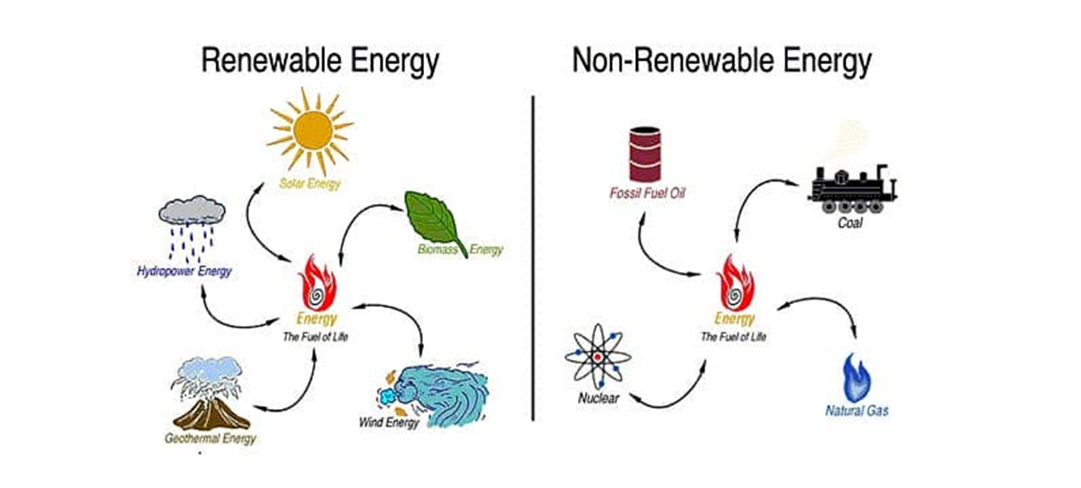
Some of natural resources are renewable, while others are not….
Renewable resources are water, timber, and sunlight.
Conservation of renewable natural resources means limiting there consumption to a slower rate slower that their replacement rate.
Non-renewable resources are fossil fuels( oil, natural gas, and coal).
That can be conserved by maintaining a sufficient amount to be utilized by future generation.

Slide 5
Applied issues in conservation
The grand challenge for conservation of ecosystem is simple to state, but complex to solve.
The Earth supports over seven billion people, with increasing human population, resource consumption, and environmental footprint.
Many other species are up to nine orders of magnitude fewer in number, threatened by habitat degradation, hunting and harvesting, pathogens and pollution.
There are no longer any safe havens for any species, anywhere. Conservation of biological diversity is thus simultaneously important, urgent, insufficient, underfunded, controversial, and politicized.

Slide 6
Issues in conservation
Immediate threats to conservation ecosystem are well-known.
They include:
loss and degradation of habitat,
climate change,
chemical and biochemical pollution,
logging (cutting of trees),
poaching (illegal hunting and capturing of wild animal),
invasive species,
disease,
loss of plant pollinators.

Slide 7
Habitat loss refers to the disappearance of natural environments that are home to particular plants and animals.

Slide 8
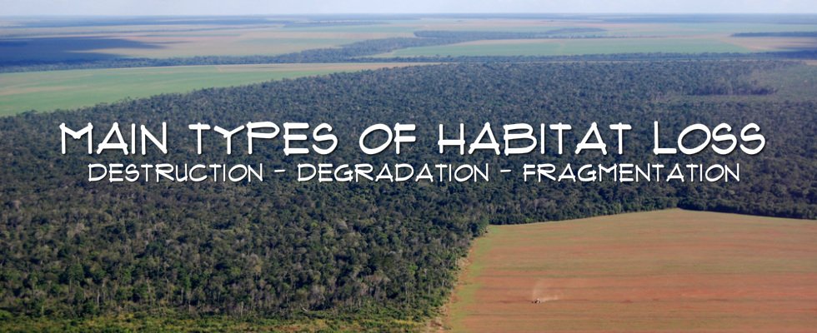
Habitat destruction is the process by which natural habitat is damaged or destroyed to such an extent that it no longer is capable of supporting the species and ecological communities that naturally occur there.
Habitat degradation describing the set of processes by which habitat quality is reduced.
Human development also leads to habitat fragmentation, as wild areas are carved up and split into smaller pieces.

Slide 9
Habitat loss
Habitat can be destroyed directly by many human activities, most of which involve the clearing of land for uses such as agriculture, mining, logging, hydroelectric dams, and urbanization.

Slide 10
Overexploitation
Overexploitation means harvesting species from the wild at rates faster than natural populations can recover. Overfishing and overhunting are both types of overexploitation. Currently, about a third of the world's endangered vertebrates are threatened by overexploitation.
Overexploitation, also called overharvesting, refers to harvesting a renewable resource to the point of diminishing returns.
The increasing global demand for seafood have people taking more fish from oceans, lakes and rivers than is sustainable.
Beyond their role in the food supply, freshwater and marine fish are also trapped for the aquarium trade and fished for sport.

Slide 11
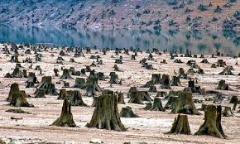
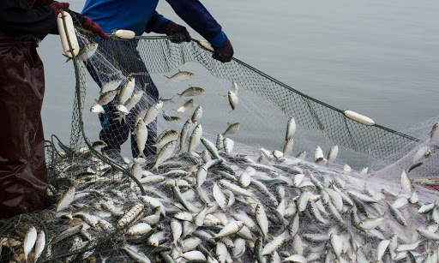
Overexploitation
A big pile of bison skulls in the 1870s. The skulls were ground into fertilizer.

Slide 12
CONSEQUENCES OF THE OVEREXPLOITATION OF NATURAL RESOURCES
The uncontrolled consumption of natural resources has significant effects:
Environmental
The disappearance of habitats essential for flora and fauna and, therefore, the extinction of species.
There are some 30 million different animal and plant species in the world, and of these, the International Union for Conservation of Nature (IUCN) says that, currently, more than 31,000 species are threatened with extinction.

Slide 13
CONSEQUENCES OF THE OVEREXPLOITATION OF NATURAL RESOURCES
Economic
33% of the world's soils are moderately to highly degraded, according to a United Nations Food and Agriculture Organization (FAO).
If the erosion of fertile soil continues at the same rate, agricultural commodity prices will inevitably soar.
For Health
If we do not take care of the forests there will be fewer CO₂ sinks and therefore more air pollution.
According to the World Health Organization (WHO), nine out of ten people worldwide breathe air with high levels of pollutants and seven million people die each year air pollution.

Slide 14
Climates change
The term climate refers to the general weather conditions of a place over many years.
Climate change is a significant variation of average weather conditions (e.g. conditions becoming warmer, wetter or drier over several decades or more).
Its that longer-term trend that differentiate climate change from natural weather variability.
Climate change is recognized as one of the biggest threats to our natural world and its biodiversity, as well as to global security, human health and well-being

Slide 15
What causes climate change?
Natural causes of climate change:
The earth has gone through warm and cool phases in the past, and long before humans were around. Forces that contribute to climate change include the sun’s intensity, volcanic eruptions, and changes in naturally occurring greenhouse gas concentrations.
Records indicate that today’s climatic warming—particularly the warming since the mid-20th century—is occurring much faster than ever before.
According to NASA “These natural causes are still in play today, but their influence is too small or they occur too slowly to explain the rapid warming seen in recent decades”

Slide 16
Anthropogenic causes of climate change
Humans—more specifically, the greenhouse gas (GHG) emissions we generate—are the leading cause of the earth’s rapidly changing climate.
Greenhouse gases play an important role in keeping the planet warm enough to inhabit.
According to the intergovernmental panel on climate change (IPCC), concentrations of carbon dioxide, methane, and nitrous oxides “have increased to levels unprecedented in at least the last 800,000 years.”

Slide 17
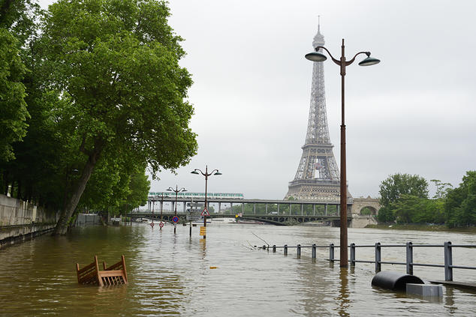
The effects of global climate change
As climate change transforms global ecosystems, it affects everything from the places we live to the water we drink to the air we breathe.
Extreme weather
As the earth’s atmosphere heats up, it collects, retains, and drops more water, changing weather patterns and making wet areas wetter and dry areas drier.
A view of the Seine river flood in Paris near Bir-Hakeim bridge, which reached a 30-year high in June 2016

Slide 18
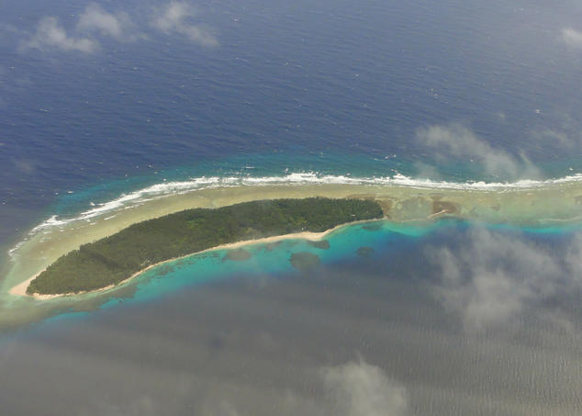
The effects of global climate change
Rising seas
The Arctic is heating twice as fast as any other place on the planet.
Aerial of the Marshall Islands landscape, which are feeling the effects of rising sea levels

Slide 19
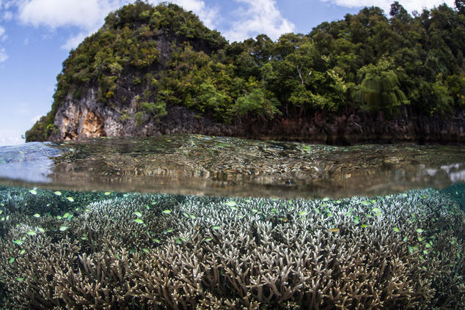
The effects of global climate change
Warmer, more acidic oceans
The earth’s oceans absorb between One-quarter and one-third of our fossil fuel emissions and are now 30 percent more acidic than they were in preindustrial times.
Fish and corals near Limestone Island, Indonesia

Slide 20
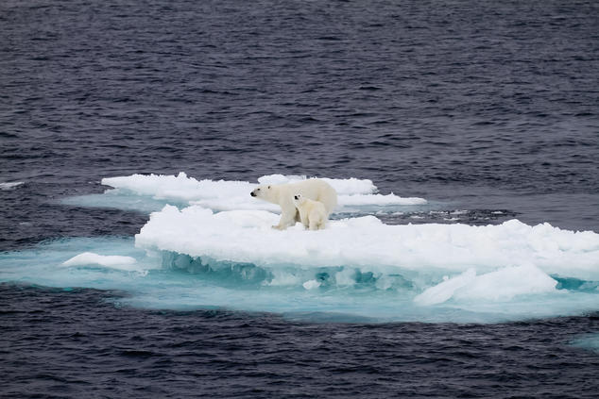
The effects of global climate change
Imperiled ecosystems
Climate change is increasing pressure on wildlife to adapt to changing habitats—and fast. Many species are seeking out cooler climates and higher altitudes, altering seasonal behaviors, and adjusting traditional migration patterns.
Two polar bears on a small ice floe

Slide 21
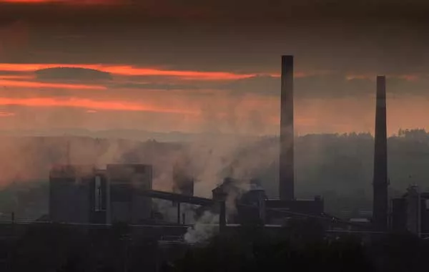
Pollution
Pollution is the process of making land, water, air or other parts of the environment dirty and not safe or suitable to use.

Slide 22
Types of pollution
Land pollution
Water pollution
Air pollution
Noise pollution
Light pollution

Slide 23
Types of pollution
Land pollution
Land can become polluted by household garbage and by industrial waste.
Organic material was the largest component of the garbage generated, the EPA said.
Commercial or industrial waste is a significant portion of solid waste.
Water pollution
Water pollution happens when chemicals or dangerous foreign substances are introduced to water, including chemicals, sewage, pesticides and fertilizers from agricultural runoff, or metals like lead or mercury.

Slide 24
Types of pollution
Air pollution
Air pollution occurs when things that aren't normally there are added to the air. A common type of air pollution happens when people release particles into the air from burning fuels.
Noise pollution
Even though humans can't see or smell noise pollution, it still affects the environment. Noise pollution happens when the sound coming from planes, industry or other sources reaches harmful levels.
Light pollution
Light pollution is the presence of anthropogenic and artificial light in the night environment. It is exacerbated by excessive, misdirected or obtrusive use of light, but even carefully used light fundamentally alters natural conditions.

Slide 25
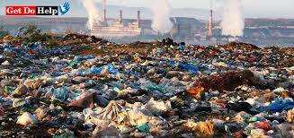
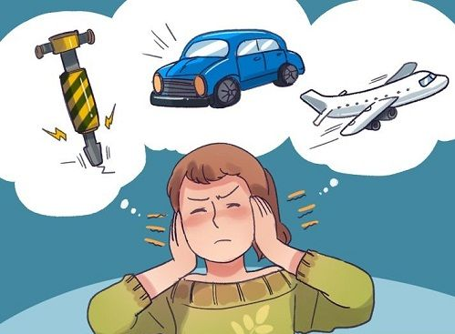
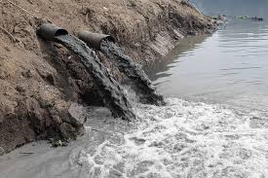
Types of pollution

Slide 26
Logging
Logging involves cutting trees for sale as timber or pulp. The timber is used to build homes, furniture, etc and the pulp is used to make paper and paper products.
Logging is generally categorized into two categories:
Selective logging
is selective because loggers choose only wood that is highly valued.
Clear-cutting.
Clear cutting is not selective. Loggers are interested in all types of wood and therefore cut all of the trees down, thus clearing the forest, hence the name- clear-cutting.

Slide 27
Logging
Logging in Malaysia.

Slide 28
Logging
Rainforest logging in Indonesia.

Slide 29
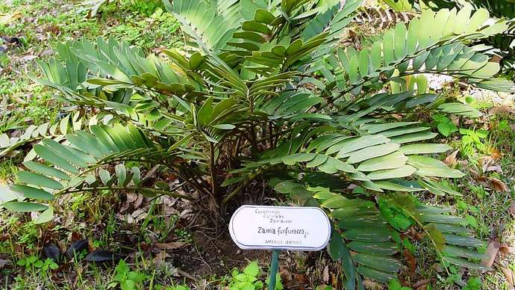
Poaching
Poaching, in law, the illegal shooting, trapping, or taking of game, fish, or plants from private property or from a place where such practices are specially reserved or forbidden. Poaching is a major existential threat to numerous wild organisms worldwide and is an important contributor to biodiversity loss.
Cardboard palm (Zamia furfuracea). The plant is an endangered species and is threatened by overcollection and habitat loss.

Slide 30
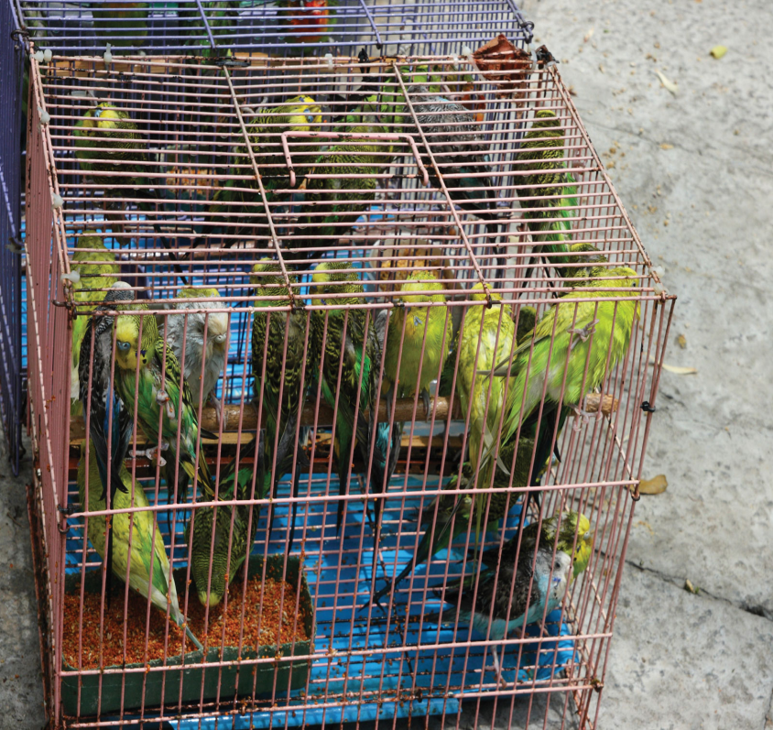
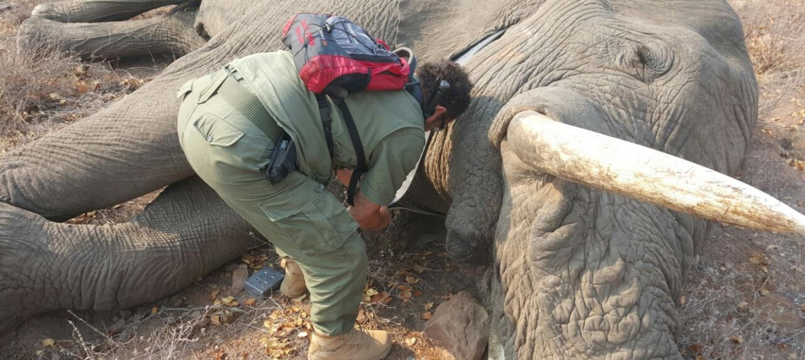
Poaching
Confiscated black-market elephant tusks await disposal in 2013

Slide 31
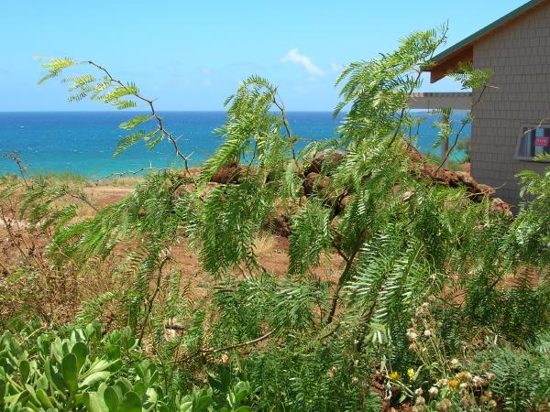
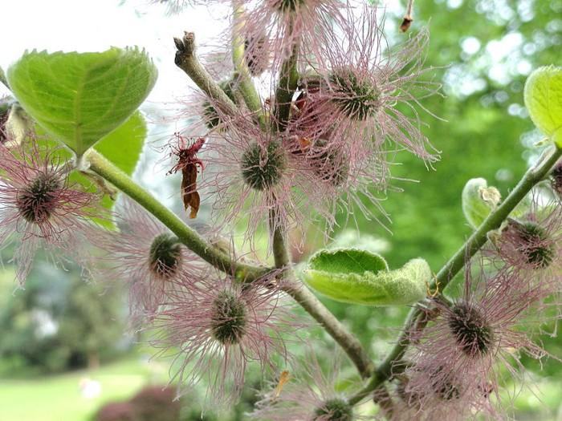
Invasive species
Invasive Alien Species, often called as exotic, non-native species, having arrived outside their natural distribution to areas where they easily invade ecosystems, marginalise several native species which brings about large scale environmental, ecological, and economic damage
Prosopis juliflora
Mulberry tree

Slide 32
Lion fish
Lionfish Native to the Indo-Pacific oceanic region, lionfish are quickly spreading throughout the coasts and coral reefs of the East Coast of the United States. Lionfish are voracious eaters and their venomous dorsal spines have helped to protect them so far from any natural predation in the Atlantic

Slide 33
THANK YOU

